Slide 1


Needs-based economic policy for a green caring just transition
Özlem Onaran
based on
Onaran and Oyvat 2023, Onaran, Oyvat, Fotopoulou 2023

Slide 2
Big picture
Multiple challenges –happening now not a dystopian Sci-Fi
      ecological breakdown
      care needs in an aging society
      inequalities: class, race and gender
      technological change, AI –this time it is different
  cost of living crisis
interlinked
Neither can be solved alone in isolation
Public investment needs in
    social infrastructure in the care economy
    green economy
Paradigm shift: Needs based approach to policy
  address both the care and ecological deficits, while tackling inequalities
  avoid competition between needs
Use all tools and all means of funding
Coordinate: fiscal, monetary, industrial, labour and social policies
Long-run thinking
  Short-run emergency →medium-run
There is a way and neither rocket science nor utopian

Slide 3
Outline
A structuralist Post-Keynesian/Kaleckian gendered model
Methodology
Econometric findings and policy simulations
Conclusions and policy implications

Slide 4
A structuralist Post-Keynesian/Kaleckian gendered model
demand-led growth model
  Onaran, Oyvat Fotopoulou (2022a,b, 2023); Oyvat and Onaran (2022)
    synthesizes PK and feminist macro
demand-side constraints → excess capacity, involuntary unemployment
public spending
→demand, income distribution, employment
→ the supply side: productivity and labour supply
the dual effects of wages on costs and demand
distribution of wealth and income and gender gaps →demand and productivity,
structural features of the economy matter
  Sectoral
  import dependency
  Gender
  Oligopoly power
  Bargaining power
  Public infrastructure

Slide 5
A structuralist Post-Keynesian/Kaleckian gendered model
Three Sectors of the economy
  Care economy: health, social care, education, childcare (H)
  rest of the market economy (N)
  unpaid domestic care sector

Slide 6
  A structuralist Post-Keynesian/Kaleckian gendered macro model:
  Demand side
Public spending
green
    renewable energy (solar, wind, hydro, geothermal),
    energy efficiency (insulation, industry, grid),
    public transport (excluding air transport)
    =REEEPT
care economy/social infrastructure (Y^{H})
  education, childcare
  health, social care
  Other infrastructure (GFCFC, I^{G}):
    e.g. social housing, schools, hospitals

Slide 7
  A structuralist Post-Keynesian/Kaleckian gendered macro model:
  Demand side
Consumption in care (H) & rest of the economy (N) functions of
  after-tax female & male wage & profit income, wealth of 1% & 99%, gov spending
Private Investment function of
  after-tax profit share, output, wealth of 1% & 99%, gov spending, public debt/GDP
Exports: function of profit share, Yworld, exchange rates
Imports: function of profit share, Y_{N}, exchange rates
  Taxes are collected on wage and capital income, wealth, & C
  Debt/GDP depends on government spending, taxes and Y
Unpaid domestic care function of
  public and private household spending in care and demographic structure

Slide 8
...Model: Supply side
Productivity (output/hour)
  endogenous in the medium run in the rest of the economy
  function of
    wages, output, public spending, private investment, C_{H}, unpaid care
labour force participation of women & men depend on
  wages, social infrastructure, unpaid care

Slide 9
...Model: Employment
    Employment of men & women in hours
      Determined by output and productivity
  Subject to occupational segregation in N and H
    Endogenous

Slide 10
…Model: Distribution and price setting
Prices: mark-up on unit labour costs and other input costs
  Medium run: effects of wages on productivity → moderate price effects
Wage bargaining: function of employment/labour force (of men & women and each other’s wages)
Wages, gender gap, taxes → functional income & wealth distribution
Private net wealth (PW)
  function of after tax female & male wage and profit income and its past value
Wealth concentration=PW of top1%/PW

Slide 11
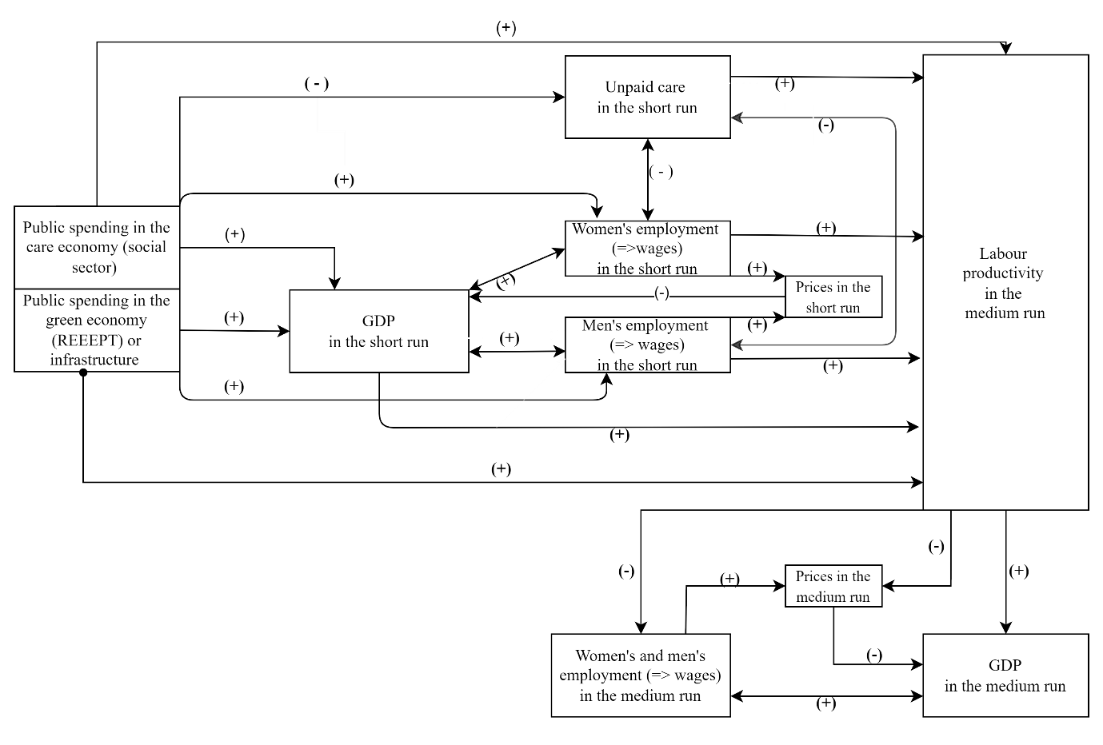
The effect of public spending on employment, output and labour productivity

Slide 12
Empirical Literature
Strong effects on GDP and employment
  Care economy
    İlkkaracan et al, 2015; İlkkaracan and Kim, 2019/ILO, 2020; ITUC, 2016, 2017; Onaran, Oyvat, Fotopoulou, 2022, 2023; Oyvat and Onaran, 2022
  Green economy
    Batini et al, 2021; Dafermos and Nikolaidi, 2019; Pollin et al, 2009; 2015; 2022; IRENA 2020
  Infrastructure
    IMF 2020; Wildauer et al, 2022; Onaran, Oyvat, Fotopoulou, 2023, 2022,

Slide 13
Estimation Methodology
Onaran, Oyvat, and Fotopoulou 2023, 2022a, b
  UK
  Single equation estimations for C in H & N I, X, M, PW, PW1/PW
  Panel fixed effects using 5 year averages for productivity
    18 sectors other than education, health, care
    five year non-overlapping average of explanatory variables starting from 1970 and of the dependent variable starting from 1971
  Instrumental Variables - GMM
    IV: α, β in H and N, t_{R}, t_{W}, t_{PW}, G^{H}/Y, PW1/PW, Yworld, strike days/E, union density, capital account openness, in t, t-1, t-2, +sectoral VA in US, EU12 for productivity
  Robustness check: OLS
    Systems estimation: Seemingly Unrelated Regression for C in H & N
  Data: EUKLEMS, AMECO, WWID, EC, ONS 1970-2016
Onaran and Oyvat 2023, ITUC Project
  REEE based on IO analysis in Pollin et al. (2015), PT: APTA (2020)
  VAR, 8 emerging economies

Slide 14
Green caring just transition with full employment with decent jobs
higher output in both short run and medium run
  multiplier effects on GDP in most countries in all spending categories >1 in the medium run (end of 5 years)
A strong productivity effect of public spending
Public spending is partly self-financing
differences in the magnitude of the multipliers depending on
  import dependency
  informality
  Composition/targeted nature of spending

Slide 15
Policy simulation, UK
Fiscal policy
  government spending in social purple vs physical green infrastructure/GDP ↑ 1%-point
    E.g. increasing employment, hiring nurses, social care workers, teachers or investing in renewable energy, energy efficiency, public transport
    increasing wage rates: e.g. paying higher wages to care workers, nurses…
    closing gender wage gap via upward convergence: e.g. increase the wage at the bottom of the scale more, enforce equal pay legislation →2%↑ in women’s and 1%↑ in men’s wages
progressive income and wealth taxation
  tax rate on wealth ↑ 1%-point (doubling of tax on wealth)
  tax rate on profit income ↑ 1%-point
  tax rate on wages ↓ 1%-point
Labour market policies: Increase hourly real wage rate and close gender gaps via upward convergence in the rest of the economy

Slide 16
Policy simulation, UK
higher output in both short run and medium run
A strong productivity effect of public spending
Employment of both women & men↑ in short & medium run
  E_{female} ↑ 9.6%, E_{male} ↑ 5.8% (in medium run)
Improved public finance
  public debt/GDP ↓ 10.3%-point (in medium run)
  public spending is partly self-financing
  taxing of wealth in particular and profits have a strong effect on tax revenues

Slide 17
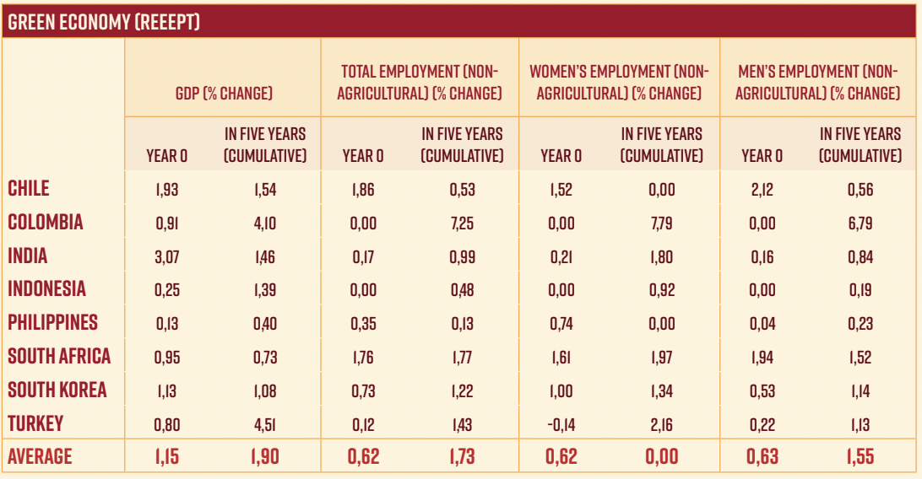
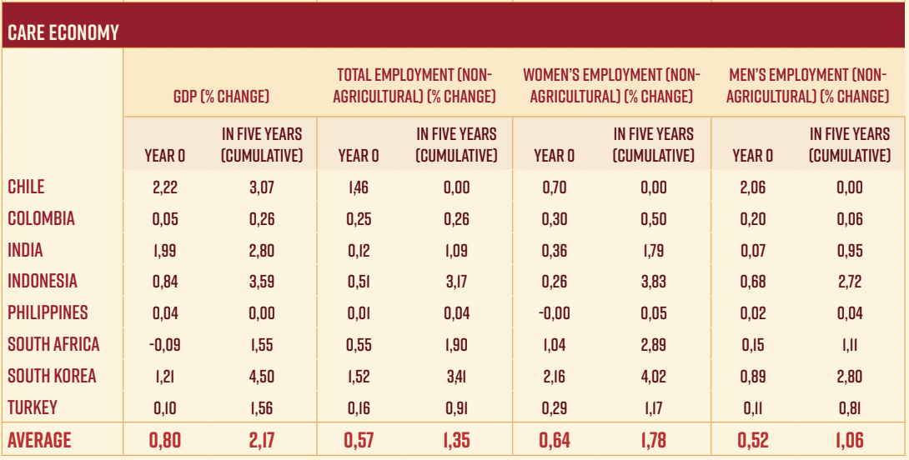
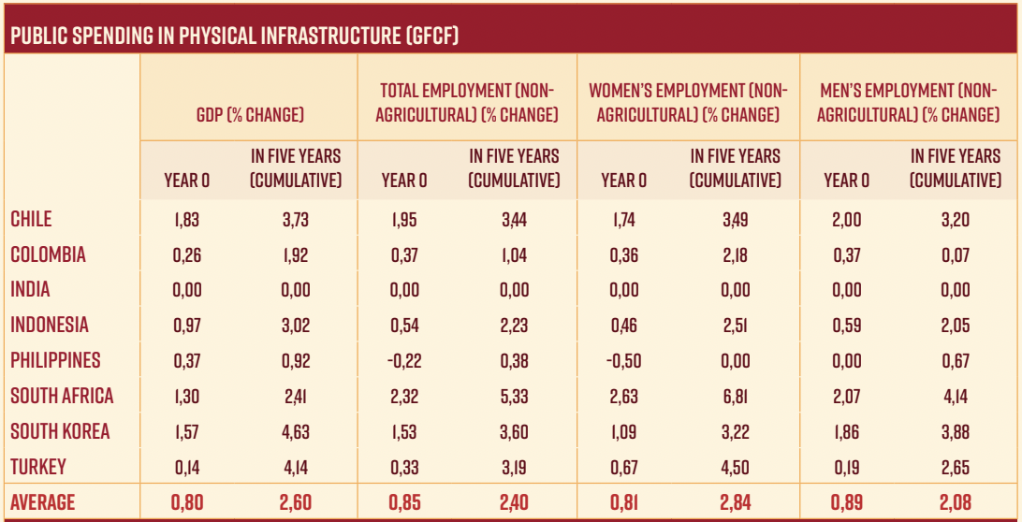
Policy simulation -emerging economies: effects of a one-off increase in the green economy, the care economy and public physical infrastructure by 1%-point/GDP on GDP and employment (non-agricultural).
  GDP multiplier in 5 yrs, cumulative (one-off increase)
  Green: 1.1 in South Korea - 4.5 in Turkey
    sum of effects of sectors providing input to REEEPT
    Exception: Philippines 0.4
  care: 1.6 in Turkey & South Africa - 4.6 in South Korea
    Exception: Colombia and Philippines 0.2
  infrastructure: 1.9 in Colombia - 4.6 in South Korea
    Exception: Philippines 0.9, India insignificant

Slide 18
Green caring just transition: Policy mix
public spending in the care + green economy + other infrastructure
repeated annual ↑ for 5 years, by 1%-point as a ratio to GDP
new jobs:
  320k Philippines,
  2.1m Chile
  4.9m Turkey
  7.9m Colombia
  9m South Africa
  12.6m South Korea
  27.6m India
  22.4m Indonesia
→Space for redeployment from
fossil-fuels

Slide 19
What are the effects of taxation, UK?
tax rate on wealth↑
  wealth concentration↓ →financialization and market concentration ↓
  →Investment↑
  very strong + impact on output, employment of women and men and the budget balance in both the short and medium run
  Key for a needs-based fiscal policy to tackle multiple challenges
An increase in the progressivity of income taxation
  tax rate on profit income ↑
  tax rate on wages ↓
  output, employment of women and men↑, and public debt/GDP↓ in both the short and the medium run.
  Because in the UK higher wages and equality lead to higher output
  the UK economy is wage-led

Slide 20
Conclusions and policies for a green caring just transition: a needs-based approach
Public investment leading the way: urgent and large scale
    green economy
    Purple care economy / social infrastructure
    other infrastructure
    Complementarities: Purple and green : redeployment from the fossil fuels, care jobs are lower in CO2 emissions, labour intensive
Embedded in a democratic participatory plan at least covering the key sectors
  publicly owned enterprises (central, local, cooperatives)
How can we fund?
  partly self-financing; high multipliers; there is money!
  borrowing: Redefine infrastructure and fiscal rule
  progressive taxation of not just income but also wealth
  national investment bank (networked with public banks, cooperative banks),
  Accommodating monetary policy: target full employment & inflation;
    CBs to buy government bonds in primary markets
    higher weight on employment & inflation target consistent with full emp: eg 4-5% rather than as low as possible
    monetary policy should accommodate an expansionary fiscal policy

Slide 21
…Conclusions and policy implications
Fiscal policy effects are very strong even when applied in a single country
Fiscal and labour market policies enhance each other, Obst, Onaran, Nikolaidi, 2020
  Collective bargaining, regulation, minimum wages,
  recognize, reduce, redistribute unpaid care (Elson)
    Universal free child care and social care, Equal incentives for both men and women regarding parental leave
  Shorter hours with wage compensation for the lower wage earners
  → gender equality in paid and unpaid work↑ Onaran & Calvert Jump 2021
A strong productivity effect of public spending +green transition
  relaxes balance of payments constraint
International policy coordination
  effects are stronger when coordinated across countries
    EU: Obst, Onaran, Nikolaidi, 2020; G20: Onaran 2016, Onaran and Galanis 2014

Slide 22
Selected References
Onaran, O., Oyvat, C., Fotopoulou, E. 2023 Can wealth taxation fund public investment in a caring and sustainable economy? the case of the UK, Cambridge Journal of Economics
Onaran, Ö., Oyvat, C., Fotopoulou, E. A macroeconomic analysis of the effects of gender inequality, wages, and public social infrastructure: the case of the UK, Feminist Economics, 28(2):152-188, 2022
Onaran and Oyvat, 2022 “The effects of public investment in the green and care economy on employment in emerging economies”, funded by the International Trade Union Confederation (ITUC),,
Onaran, Ö. and Calvert Jump, R. 2022, A shorter working week as part of a green, caring economy”, Women’s Budget Group Feminist Green New Deal Policy Paper, Shorter-Working-Week-Report.pdf (wbg.org.uk).

Slide 23
Appendix

Slide 24
A structuralist Post-Keynesian/Kaleckian gendered macro model
demand-led growth model
  Onaran, Oyvat Fotopoulou (2019, 2022a,b); Oyvat and Onaran (2022)
    synthesizes and furthers Braunstein, van Staveren, Tavani (2011) and Seguino (2010, 2012)
demand-side constraints →excess capacity, involuntary unemployment,
public spending →demand, income distribution, and employment in both the short run and the medium run as well as on the supply side on productivity in the medium run,
the dual effects of wages on costs and demand
distribution of wealth and income between wages and profits and gender gaps →demand and productivity,
structural features of the economy matter
  sectoral composition,
  oligopolistic price setting,
  import dependency,
  bargaining power between labour and capital and between genders,
  gender differences in the distribution of unpaid and paid labour in different sectors,

Slide 25
A Post-Keynesian/Kaleckian gendered macro model
Three Sectors of the economy
  Care economy: health, social care, education, childcare (H)
  rest of the market economy (N)
  unpaid domestic care sector

Slide 26
  A structuralist Post-Keynesian/Kaleckian gendered macro model:
  Demand side
Consumption in care (H) & rest of the economy (N) functions of
  after-tax female & male wage & profit income, wealth of 1% & 99%, gov spending
Private Investment function of
  after-tax profit share, output, wealth of 1% & 99%, gov spending, public debt/GDP
Exports: function of profit share, Yworld, exchange rates
Imports: function of profit share, Y_{N}, exchange rates
3 types of government spending
    care economy/ social infrastructure: education, childcare, health, social care (Y^{H})
    green: renewable energy (solar, wind, hydro, geothermal), energy efficiency (insulation, industry, grid), public transport (excluding air transport) (REEEPT)
    Other infrastructure (GFCFC): e.g. social housing, schools, hospitals (I^{G})
  Taxes are collected on wage and capital income, wealth, & C
  Debt/GDP depends on government spending, taxes and Y
Unpaid domestic care function of
  public and private household spending in care and demographic structure

Slide 27
...Model: Supply side
Productivity (output/hour)
  endogenous in the medium run in the rest of the economy
  function of
    wages, output, public spending, private investment, C_{H}, unpaid care
labour force participation of women & men depend on
  wages, social infrastructure, unpaid care

Slide 28
...Model: Employment
    Employment of men & women in hours
      Determined by output and productivity
  Subject to occupational segregation in N and H
    Endogenous

Slide 29
…Model: Distribution and price setting
Prices: mark-up on unit labour costs and other input costs
  Medium run: effects of wages on productivity → moderate price effects
Wage bargaining: function of employment/labour force (of men & women and each other’s wages)
Wages, gender gap, taxes → functional income & wealth distribution
Private net wealth (PW)
  function of after tax female & male wage and profit income and its past value
Wealth concentration=PW of top1%/PW

Slide 31
The impact of an increase in public spending on aggregate demand
 | Direct effects in the short run |  | Direct effects in the medium run
 | Public spending in the social sector (care economy) | Public spending in REEEPT (green economy) or infrastructure | Public spending in the social sector (care economy) | Public spending in REEEPT (green economy) or infrastructure
Consumption in N | Rising employment in H (+) | Rising employment in N (+) Reducing private consumption by public provision (-) | Rising productivity and profit share (?) | Rising productivity and profit share (?)
Consumption in H | Direct positive effect (+) Rising employment in H (+) Reducing private consumption by public provision (-) | Rising employment in N (+) | Rising productivity and profit share (?) | Rising productivity and profit share (?)
Private investment | Change in public debt/ GDP (-/0?) | Change in public debt/ GDP (-/0?) Improved business environment or infrastructure (+) Substitute private investment in infrastructure (-) | Rising productivity and profit share (+) Change in public debt/GDP (-/0?) | Rising productivity and profit share (+) Change in public debt/GDP (-/0?)
Government expenditures | Direct positive effect (+) | Direct positive effect (+)
Net exports | 0 | Negative effect due to increase in imports (-) | Rising productivity and lower real unit labour costs (+) | Rising productivity and lower real unit labour costs (+) Negative effect due to increase in imports (-)

Slide 32
The magnitude of the multiplier effects
Depends on
  i) the labour intensity of the sectors receiving the extra spending,
  ii) the marginal propensity to import out of the new spending,
  iii) the effects on household consumption by substituting private spending,
  iv) the effects on private investment by providing public infrastructure (+/-?)
  v) the gender composition of new employment (effects both the mpc and Ch/C)
Batini et al 2021 (IMF): strong multiplier effect of renewable energy infrastructure (1.4-1.5) > Non-EcoFriendly Energy Investments Multiplier (0.6-0.5)

Slide 33
Data and empirical methodology
8 emerging economies:
  Chile, Colombia, India, Indonesia, Philippines, South Korea, South Africa, Turkey
Green economy –REEEPT
  50% allocated to renewable energy, Pollin et al. (2015)
    equally among wind, solar, geothermal and hydropower.
  20% allocated to energy efficiency, Pollin et al. (2015)
    50% →weather proofing/energy efficiency in buildings;
    25% → industrial energy efficiency,
    25% →grid upgrades.
  30% allocated to public transport, APTA (2020)
    10% → rail transport vehicles (investment)
    18% → construction (infrastructure)
    72% → transport services
spending in REEEPT by 1%-point as a ratio to GDP →
  REEE based on I-O analysis in Pollin et al. (2015), PT: APTA (2020)
  manufacturing sub-industries 0.46%-point/GDP (Y^{MRE})
    Sum of plastic, glass, cement, plaster, concrete, non-ferrous metals, fabricated metal, general purpose machinery, special purpose machinery, domestic appliances, electrical machinery and apparatus, electronic valves, tubes,, locomotives & rolling stock, other transport equipment
  Construction: 0.33%-point/GDP (Y^{C})
  transport services: 0.21%-point/GDP (Y^{PT})

Slide 34


…Methodology
Systems estimation: Public spending, output (Y), employment of women & men
  GFCF (I^{G}) & care (Y^{H})
  manufacturing sub-sectors (Y^{MRE}), Construction (Y^{C}), transport services (Y^{PT})
$X_{t}=\left[\begin{matrix}logY_{t}^{C} \\ logY_{t}^{PT} \\ logY_{t}^{MRE} \\ \log\left(Y_{t}\right) \\ \log\left(E_{t}^{M}\right) \\ \log\left(E_{t}^{F}\right)\end{matrix}\right]$
$X_{t}=\left[\begin{matrix}\begin{matrix}{log⁡(I}_{t}^{G}) \\ logY_{t}^{H} \\ \log\left(Y_{t}\right) \\ \log\left(E_{t}^{M}\right)\end{matrix} \\ \log\left(E_{t}^{F}\right)\end{matrix}\right]$
or
Vector Auto Regression with Cholesky decomposition, one lag
Estimation period 1972 (South Korea)-1994 (South Africa)→2018
Alternatives:
  total employment instead of employment of men and women
  first differences
  estimation period starting in 1980s (rather than 1970s)
  alternative orders of public spending categories;
  two or three lags
  trend or other exogenous control variables
  population (+15), informal economy/GDP, urbanization, real exchange rate, world GDP
  trade openness/GDP, oil rent/GDPworld, mineral rent/GDPworld…

Slide 35
The cumulative % change in GDP and employment (non-agricultural) at the end of five years in response to increasing spending in the green economy (sum of effects of sectors providing input to REEEPT) by 1%-point/GDP every year
  GDP average: 10.0%
    1.9% Philippines, 4.8% Indonesia, 12.7% India, 22.0% Turkey.
  total employment average: 7.5%
    0.9% Philippines and Indonesia, 5.7% Turkey, 27% Colombia

Slide 36
The cumulative % change in GDP and employment (non-agricultural) at the end of five years in response to increasing spending in care economy by 1%-point/GDP every year
  GDP average: 11.0%
    1.3% Colombia, 4.9% Turkey, 15.3% Indonesia, 16.9% India, 23.7% Korea
  Employment average:6.3%
    1.5% in Chile, 3.1% Turkey, 12.5% Indonesia, 4.6% India, 18.0% Korea
  jobs for both women and men, albeit at a faster rate for women.

Slide 37
The cumulative % change in GDP and employment (non-agricultural) at the end of five years in response to increasing spending in public physical infrastructure by 1%-point/GDP every year
  GDP average: 12.1%
    4.1% in Philippines - 23.5% in South Korea
  total employment average: 12.4%
    1.5% in India - 31.5% in South Africa.
  in 6 countries employment of both men and women increase
  Chile, Colombia, Indonesia, South Africa, Turkey: %↑E_{women}>E_{men}
  importance of gender mainstreaming in assessing the employment impact

Slide 38
Cumulative Impulse Response Functions: GDP to REEEPT
South Korea
South Korea
Turkey

Slide 39
Cumulative Impulse Response Functions: employment to REEEPT
South Korea
South Korea

Slide 40
Cumulative impulse response functions: GDP and employment response to public spending in physical infrastructure and care
South Korea

Slide 41
The cumulative % change in GDP, women’s and men’s and total employment (all in non-agricultural sector) in response to a 1%-point increase (one-off) in public GFCF as a ratio to GDP

Slide 42
The cumulative % change in GDP, women’s and men’s and total employment (all in non-agricultural sector) in response to a 1%-point increase (one-off) in public spending in the care economy as a ratio to GDP

Slide 43
The cumulative % change in GDP, and women’s and men’s employment (and total employment, all in non-agricultural sector) in response to a 1%-point increase (one-off) in public spending in the green economy (REEEPT) as a ratio to GDP

Slide 46
Source: : İlkkaracan and Kim, 2019, also reported in ILO 2020

Slide 47
Source: *Ratios to GDP are own calculations based on required investment amount reported in Bertram et al. (2021).
**McCollum, et al. (2018) Supplementary Data Tables

Slide 50
Cumulative Impulse Response Functions: GDP to REEEPT
South Korea
Turkey

Slide 51
Cumulative Impulse Response Functions: employment to REEEPT
South Korea

Slide 52
Cumulative impulse response functions: GDP and employment response to public spending in physical infrastructure and care
South Korea

Slide 53
Cumulative Impulse Response Functions: employment to REEEPT
Turkey

Slide 54
Cumulative impulse response functions: GDP and employment response to public spending in physical infrastructure and care
Turkey

Slide 55
Cumulative impulse response functions Chile

Slide 56
Cumulative impulse response functions Colombia

Slide 57
Cumulative impulse response functions India

Slide 58
Cumulative impulse response functions Indonesia

Slide 59
Cumulative impulse response functions Philippines

Slide 60
Cumulative impulse response functions South Africa

Slide 61
Cumulative impulse response functions South Korea

Slide 62
Cumulative impulse response functions Turkey

Slide 63
Cumulative impulse response functions Chile

Slide 64
Cumulative impulse response functions Chile

Slide 65
Cumulative impulse response functions Colombia

Slide 66
Cumulative impulse response functions Colombia

Slide 67
Cumulative impulse response functions India

Slide 68
Cumulative impulse response functions India

Slide 69
Cumulative impulse response functions Indonesia

Slide 70
Cumulative impulse response functions Indonesia

Slide 71
Cumulative impulse response functions Philippines

Slide 72
Cumulative impulse response functions Philippines

Slide 73
Cumulative impulse response functions South Africa

Slide 74
Cumulative impulse response functions South Africa

Slide 75
Cumulative impulse response functions South Korea

Slide 76
Cumulative impulse response functions South Korea

Slide 77
Cumulative impulse response functions Turkey

Slide 78
Cumulative impulse response functions Turkey

Slide 79
…Policy implications: Labour market policies
  Representation and collective voice for both women and men
  Collective bargaining coverage
  inclusive trade unions
  Labour market regulation, eg ban zero hours and false self-employment practices
establishing sufficiently high minimum wages at living wage rate
  Gender wage equality –enforce equal pay legislation
    Higher rates of pay rise at the bottom end of the scale
Recognize, reduce, redistribute unpaid care (Elson)
  Universal free child care and social care
  Equal incentives for both men and women regarding parental leave
  work-life balance as an essential component of decent jobs
  shorter working hours: downward convergence in hours
  Permanent shorter hours with wage compensation for the lower wage earners → a narrowing of gender gaps

