Slide 1
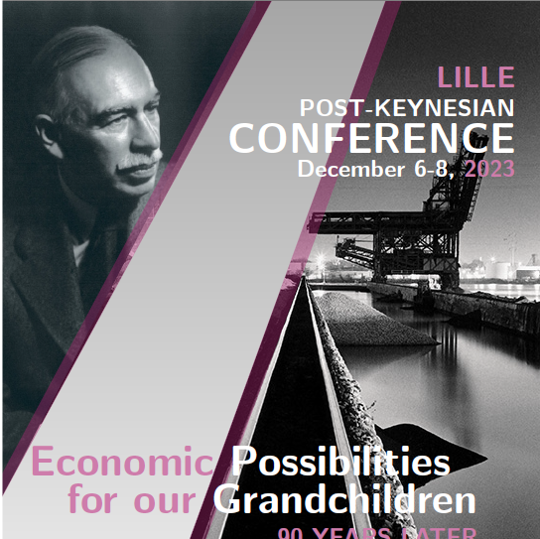
Liquidity preference, Financial Structure and Sustainable Development Finance
Jan Kregel

Slide 2
For JMK The “Economic Problem” was “Struggle for Subsistence”
Context: Revised at the beginning of the Great Depression of the 1930s
  (Finishing the Treatise where the solution was Zirp)
The short-term problem was TECHNOLOGICAL Unemployment
The Long-term problem was neurological: “we have been expressly evolved by nature …for the purpose of solving the economic problem”
“we are more concerned with the remote future results of our actions than with their own quality or with their immediate effects on our own environment”
Money as link between Present and Future
“Love of money as a possession is a somewhat disgusting morbidity” …”We must learn that “avarice is a vice … that the love of money is detestable”

Slide 3
We need to change our code of morals STOP SAVING SO MUCH
Spurious immortality of actions – Saving! Carnegie libraries
Love of money – a mental disease, a disgusting morbidity
Need to distinguish possession of money from its use as a means to enjoyment and the realities of life
Was fine for capital accumulation, not for enjoying life at the end of economic problems
BUT:
“ the moral problem of our Age is concerned with the love of money, with the habitual appeal to the money motive in nine-tenths of the activities of life, with the unusual striving after individual economic security as the prime objective of endeavour, with the social approbation of money as the measure of constructive success, and with the social appeal to the hoarding instinct as the foundation of the necessary provision of the family and the future.”
“Many of the greatest economic evils of our time are the fruits of risk, uncertainty, and ignorance … It is because particular individuals, fortunate in situation or in abilities, are able to take advantage of uncertainty and ignorance, … that great inequalities of wealth come about; and these same factors are also the cause of the Unemployment of Labour, to the disappointment of reasonable business expectations, and the impairment of efficiency and production.
“Pseudo Moral principles” need to be discarded

Slide 4
No Revolution – just stop the “money fetish”
According to Joan Robinson, Keynes’s main objection to capitalism was aesthetic. “(H)is basic view of life was aesthetic rather than political. He hated unemployment because it was stupid and poverty because it was ugly.
He was disgusted by the commercialism of modern life….
He indulged in an agreeable vision of a world where economics has ceased to be important and our grandchildren can begin to lead a civilized life.” (Robinson, [1972] 1980, p. 174).
No Going to the Ramparts for Revolution
Just Competent Dentists Rule!

Slide 5
In the General Theory “Love of money” – becomes liquidity preference
Produces Poverty in the Midst of Plenty, and an Inequitable Distribution of Income
Love of money is still bad,
but now creates unemployment
Paradox: Dispels our disquietude, responds to uncertainty, but creates uncertainty of employment
Love of money now called Liquidity preference:
it is now “rational”: It maximises returns

Slide 6
The Political Problem
The Political Problem of Mankind: Policy Design to “combine three things”
1. Economic Efficiency”: productivity?
2. Social Justice: Equality of Opportunity or Declaration of Human Rights?
3. Individual Liberty: ?
“To give unhindered opportunity to the exceptional and the aspiring”
Read Schumpeter’s: Capitalism Socialism Democracy?
Read Hayek’s: Constitution of Liberty?
“The time may arrive a little later when the community as a whole must pay attention to the innate quality, as well as to the mere numbers, of its future members”
Oooops: This is not just Euthanasia of the Rentier here
Is Eugenic engineering the work of a competent dentist!
Is it just love of money?
Or striving after individual security and defending against “risk, uncertainty and ignorance”?
Which means providing Economic Justice may substitute Love of Money?

Slide 7
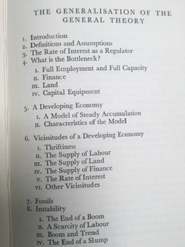
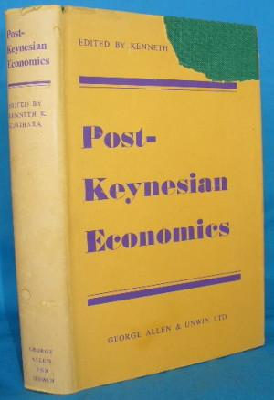
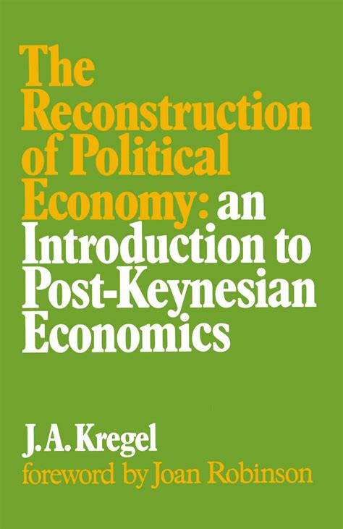
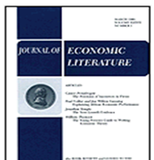
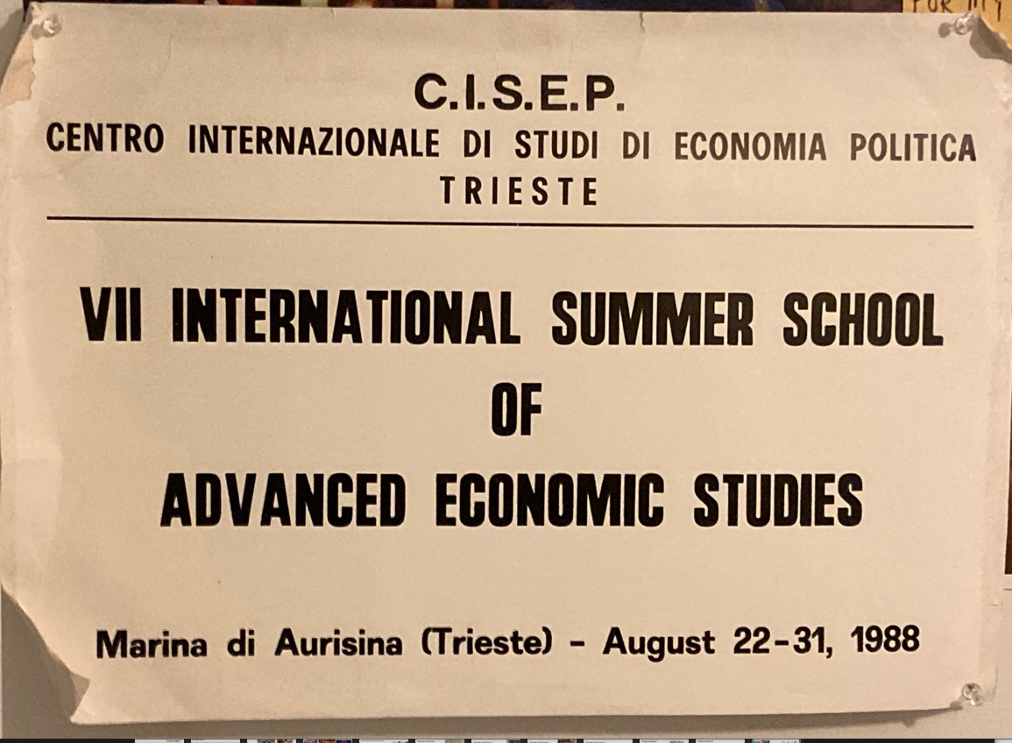
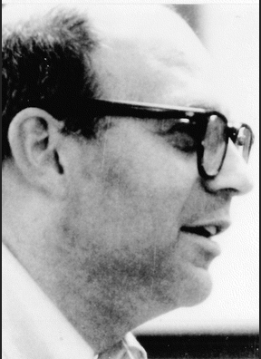
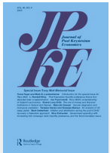
Post-Keynesian theory: some history?
Joan Robinson (1952) Kenneth Kurihara (1955) Kregel (1973) Eichner and Kregel (1975)
The French Connection: Nice (1972) Amiens (1973), Paris-Sorbonne (1983) ----------Lille
JPKE (1978) Trieste Summer School – 1980s, UT, UMKC PK Conferences 1990s

Slide 8
It started in Cambridge : Robinson, Kahn, Kaldor, Kalecki, Pasinetti …….
Joined by ……. Galbraith, Shackle, Weintraub, Boulding,, Sylos Labini, Graziani, Godley, Heilbroner, Davidson, Minsky, Rousseas
“Keynes’ General Theory of Employment is an application to output as a whole of the analysis developed by Marshall of the short-period equilibrium of a particular industry.” (1952, p. 69)
Growth and Distribution theory provided an aggregate theory of factor shares that produced an alternative to marginal productivity
To answer the question” What Determines the Rate of Profit” in long period growth theory required a theory to explain aggregate capital
Aggregate Capital and the Production Function
Sraffa’s critique of Marshall: Prices of production
Prices to ensure reproducibility of output level
Eichner: prices to ensure cash flow to finance investment and corporate competition
Critique of Supply and Demand explanation of prices

Slide 9


JR to JMK, 19-6-1935
I think I got the 'Essential Properties' in the end apart from particular points which I have noted. The only important one is about stickiness of wages. Here I believe you were led astray by Alexander for I have been arguing with him about it and I think he now agrees with my point of view.
You don't anywhere come right out in the open and say what liquidity is.
I enclose a note which I take to be what you mean. If I am right about this I don't think I have any further difficulty or disagreement.
It is extraordinary to think how many tomes have been written on this subject (Knapp and all) without a grain of sense.

Slide 10

From the French Preface:
I have called this book the General Theory of Employment, Interest and Money; and the third feature to which I may call attention is the treatment of money and prices. The following analysis registers my final escape from the confusions of the Quantity Theory, which once entangled me. I regard the price level as a whole as being determined in precisely the same way as individual prices; that is to say, under the influence of supply and demand.
And prices—both individual prices and the price-level—emerge as the resultant of these two factors. Money, and the quantity of money, are not direct influences at this stage of the proceedings.
They have done their work at an earlier stage of the analysis. The quantity of money determines the supply of liquid resources, and hence the rate of interest, and in conjunction with other factors (particularly that of confidence) the inducement to invest, which in turn fixes the equilibrium level of incomes, output and employment
and (at each stage in conjunction with other factors) the price-level as a whole through the influences of supply and demand thus established.
But it wasn’t Marshallian marginal price theory Keynes was trying to displace: It was the QUANTITIY THEORY of Prices

Slide 11
Put shortly, the orthodox theory maintains that the forces which determine the common value of the marginal efficiency of various assets are independent of money, which has ... no autonomous influence, and that prices move until the marginal efficiency of money, i.e., the rate of interest, falls into line with the common value of the marginal efficiency of other assets as determined by other forces.
My theory, on the other hand maintains that this is a special case and that... the opposite is true, namely that the marginal efficiency of money is determined by forces partly appropriate to itself, and that prices move until the marginal efficiency of other assets fall into line with the rate of interest.

Slide 12

^{Hamlet without the Prince –}
^{I got it wrong:}
^{so did the horizontalists}
PK lost sight of something important from the General Theory
Although IT HAD NOT DISAPPEARED: It was “tamed” in “tranquility
Robinson (1952): The Rate of Interest
Kaldor, Kahn: Radcliffe Report (1959),
Fellow Travellers: Minsky, Davidson, Rousseas…..
Monetarist Counter Revolution: Friedman: 1948, 1968. Quantity Theory Redux
Produced Kaldor (1982) The Scourge of Monetarism
Endogenous Money- Horizontalists v. Verticalists (Today MMT)
Paradoxically Many considered money in the GT as Exogenous!
Liquidity Preference was lost
Love of Money: Liquidity Preference
Kahn (1954) Notes on Liquidity Preference

Slide 13
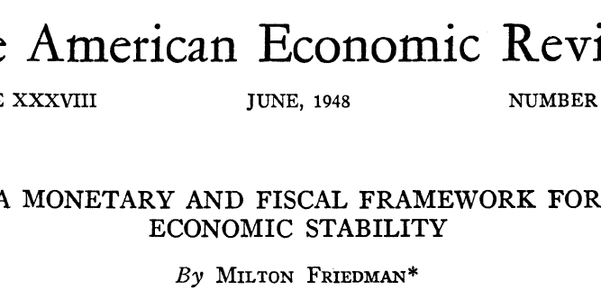
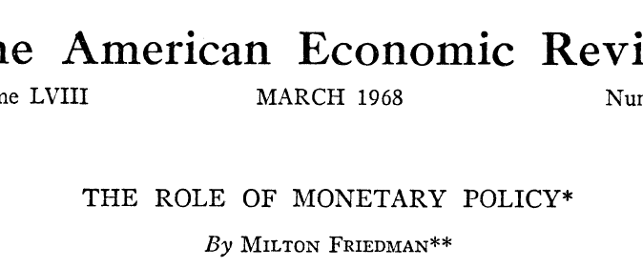
Friedman’s Revival of the Quantity Theory to Attack Keynesian Economic Policy
Changed the subject
Marginal General EquilibriumTheory was no longer the adversary

Slide 14

Indeed:
The Prince is a
Phantasma
Keynes: “Now for most important social and economic purposes what matters is the money-of-account; for it is the money of account which is the subject of contract and of customary obligation.” (1920-6)
”Money-of-Account, namely that in which Debts and Prices and General Purchasing Power are expressed, is the primary concept of a Theory of Money.” (1930)
In GT money is not exogenous, but it is undefined – Liquidity Preference is exogenous based on expectations of long interest rates
Liquidity preference is a theory of asset prices
Defines a “monetary economy” as possessing an asset whose rate of return declines more slowly than other assets in expansion, leading to equilibrium at less than full employment
It is liquidity preference -not “money” -- that causes “scarcity in the midst of Schumpeter: It may be more useful to … look upon capitalist finance as a clearing system that cancels claims and debt and carries forward the differences—so that “money” payments come in only as a special case without any particularly fundamental importance.

Slide 15

Indeed:
The Prince is a
Zombie
This is a tradition that goes back to Petty: «Mony is an artificial Thing or rather No Thing … but Is rather ye Sign of a Thing. For If men were excellently Versed in accompts Mony were not necessary at all and many places as Barbados &c have made shift without it & and so they do in Banks.”
John Law (1716), Sir James Steuart (1767) and
Adam Smith (1776): “Buying and selling upon credit, and the different dealers compensating their credits with one another, … will supply {physical money} with less inconveniency” than barter.
Ricardo (1816): instead of gold being used in exchange “money is merely written off one account and added to another”; payments “effected without the intervention of either bank notes or money.”
Schumpeter: It may be more useful to … look upon capitalist finance as a clearing system that cancels claims and debt and carries forward the differences—so that “money” payments come in only as a special case without any particularly fundamental importance. … a credit theory of money is possibly preferable to a monetary theory of credit.”
Resurrected by Colwell (1859), Withers (1906), Bendixen (1908), Schumpeter, Innes (1913), Mises, Knapp, and Luigi Einaudi’s “Imaginary money” (1936),

Slide 16
Even Menger recognized money is liquidity!!!
The classical explanations of the emergence of a commodity standard money is the solution to the problem created by double coincidence of wants. It provides information efficiency by reducing the n(n-1)/2 ratios required for bilateral exchange ratios for n commodities to n-1 exchange ratios between the commodity money and the n goods.
Menger provides a more insightful solution: “the peculiar difficulties obstructing the immediate barter of goods; …would have proved absolutely insurmountable obstacles … had there not lain a remedy in the very nature of things, the different degrees of saleableness of commodities The difference existing in this respect between articles of commerce is of the highest degree of significance for the theory of money, and of the market in general. … The theory of money necessarily presupposes a theory of the saleableness of goods.
Menger’s definition of highest degree of saleableness “as determining what is money” is equivalent to the lowest (or zero) bid-ask spread, or transaction costs a commonly used measure of market liquidity!
Money is the commodity with zero transactions costs and to intermediate quantitative and intertemporal imbalances in market supplies and demands. Money is the equivalent of the zero cost wholesale merchant or intermediary in market exchange. In short, for Menger Money is the most liquid asset!
Thus, either solving the problem of exchange with money means everything is demanded, or markets are perfect so gross substitution holds and everything is held –
Which is why Keynes argued that the Quantity theory based on physical money implied full utilization and full employment.
To escape that conclusion required replacing commodity money with liquidity.

Slide 17
From money to Credit to Liquidity to Electrons
  Exchange of goods for metallic money is a certain, non-recourse transaction (currency law)
  Credit is a time transaction – depends on uncertain future action to discharge debt
debt contracts are written in notional unit of account,
  Debt denominated in unit of account can be discharged by tender of a physical asset or by means of rendering an offsetting credit, or by a banker/accountant debiting and crediting a client account (bank money)
A.A. Berle and Pedersen:
  ”The first necessity of an economics based on exchange was the ability to exchange goods or services for other goods or services
  … with the development of money … there was not direct exchange, but exchange in goods and services for money. And this, in the satisfaction of desire, was considered a supreme achievement; because money represented not a thing in itself, but a blank claim … on anything exchangeable.
  In any civilization worthy of the name, this driving desire to achieve a blank claim on anything capable of being purchased is almost a constant in the scheme of things.” … “a blank claim is not a desire fulfilled but the promise of fulfilling desires perhaps yet unborn.“
The liquidity demand for money is not to acquire some “thing” in particular
It is not linked to the acquisition of any “particular good” and cannot be valued relative to those goods, but to some as yet unknown or unseen desire or circumstance.

Slide 18
Meyer Burstein
Modern Monetary
Theory,
THE STATE THEORY
OF MONEY REFUTED
(1986)
The Essential Properties of Money :
Everyone knows that indirect exchange is more productive than barter - But it is not widely understood that indirect exchange, while entailing money of account, does not entail a unique dedicated substance, money.
Monetary functions are ontologically distinct from things that may be called money.
Perhaps the most egregious, and surely the most influential, example of confusion of monetary functions with money-stuff is the State Theory of Money - associated with Knapp (1924) holding that money is peculiarly a creation of the state.
In the following passage Keynes correctly implies that the state has usurped monetary powers but is not intrinsically dominant in the domain of money.
‘The Age of Chartalist or State Money was reached when the State claimed the right to declare what thing should answer as money to the current money-of-account - when it claimed the right not only to enforce the dictionary but also to write the dictionary.’ (See also von Mises, 1953; and Mann, 1953, 1971.)
. . . [probably originating] in the naive belief that . . . money must have been invented . . . This belief has been wholly displaced by our understanding of the spontaneous generation of. . . undesigned institutions by a process of social evolution.
The medieval doctrine, suggestively called valor impositus, was received by Knapp, who exercised great, mostly pernicious, influence. The correct view reminds us that the theory of value and the idea of the nation state do not intersect. (See Breckenridge, 1903; Farrer, 1898; Mann, 1971; and Nussbaum, 1957.)

Slide 19
Modern Monetary
Theory, 1.2
MONEY OF ACCOUNT
1.2.1 Foundations
Meyer Burstein
Hawtrey (1947, p. 2) ‘We have to find not the historical but the logical origin of money.’ He continues (pp. 7-8):
The idea of money is dependent of that of a debt, while that of a debt is not dependent on that of money .
.. A sovereign is a coin but a pound is not. The coinage acts valued a sovereign at a pound ... A debt of a pound could be discharged with a sovereign . . . The word ‘shilling’ is ambiguous, meaning equally a twentieth part of a pound and the coin with which a debt of that amount may be paid . . . The money of account must exist before the money.
And Einaudi (1952) shows that European trade in the fourteenth and fifteenth centuries, organised outside a nation-state context, was metricised by a spontaneously generated institution Einaudi calls imaginary money.
Toynbee (1954) correctly treats money of account as part of a system of weights and measures - as does the Constitution of the United States, Article I, Sec. 8§§5:
‘the Congress shall have the power to coin money, regulate the value thereof, and of foreign coin, and fix the standard of weights and measures’.
There presses upon the simplest cultures the necessity of maintaining uniform standards of weights and measures; and measurement of value and, say, passage of time are isomorphic operations.
Measurement of weight and of value, once coincident, became The Essential Properties of Money disjoint; and the disjuncture carries the seeds of ‘public finance, money supply and inflation.’
Anciently the metrics for ‘price’ and ‘weight’ space were identical — but the mapping ceased to be 1:1.

Slide 20
Policy Implications of replacing money with liquidity preference
Keynes in a 1942 BBC radio broadcast. Critics of ambitious plans for the post-war reconstruction of London had challenged “how is it to be paid for?… Where’s the money to come from?”
To which Keynes replied “we build houses with bricks and mortar, not with money. … As a technician in these matters I can only affirm that the technical problem of where the money for reconstruction is to come from can be solved” (Keynes, CW, XXV
Keynes in the Treatise:
Banks produce it! “all deposits are ‘created’ by the bank holding them. It is certainly not the case that the banks are” (Keynes, CW: V, 23, 26)
Schumpeter: Banks create money out of nothing
Keynes could make these statements confident in the belief that his analysis in the General Theory had provided the answer to the “technical” problem of financing the required expenditure.. As many have noted, in times of war the “technical” problem of finance is easily solved, the real difficulties are in the mobilization and shifting of resources.
Savings don’t limit investment,
Finance can’t limit Investment

Slide 21
From the Reconstruction of London to the Reconstruction of Europe:
Clearing Union
The Clearing Union was not to Pool Gold Reserves
Bancor not a substitute for Gold or $,
The usually unremarked characteristic of the Clearing Union proposal
Based on the banking principle noted by
Schumacher’s multilateral clearing proposal:
You don’t need money – just a common, notional, unit of account and a bookkeeper keeping a balance sheet or clearing house
Keynes: Banking Principle: the accounting of Bank Money
It did not share reserves
It created a global clearing house of national debits and credits
It made “money” imaginary
DID NOT REQUIRE an INTERNATIONAL MONEY

Slide 22
Augmented Clearing: Schumacher’s Pool Clearing
Schumaker’s proposal for “pool clearing” -- an extension of Keynes clearing system that retains national currencies without requiring the substitution of the dollar with another national currency or a global or international money.
Importers settle foreign debts by payment of national currency to a National Clearing Fund that provides foreign settlement with the foreign credit of an exporter via a simple transfer of domestic currency from the importer to the exporter. The Funds of deficit countries will have surplus accumulation of domestic currency which they invest in Treasury bills which are held in an “International Clearing Office” while the surplus countries are deemed to share in the Pool of treasury securities , equal to the size of their respective surpluses. (op. cit: 151-2)
The International Clearing Office requires no reerves, nor does it have to create international currency. Since it is impossible to disentangle individual transactions which give rise to the various uncleared balances in the deficit countries and to ascribe any one particular balance, to any one particular surplus country, the surplus countries as a group become the joint owners of the balances in all the deficit countries. (Ibid.: 153-4)
“In this way, every national currency is made into a world currency, creation of a new world currency becomes unnecessary. The International Clearing Office is a purely administrative body, the central accounting office for the different National Clearing Funds.
The Clearing Funds of surplus countries become indebted to their internal money markets and acquire an equivalent share in the Pool; both their debt and their share in the Pool being equal to their trade surplus.
The Clearing Funds of the deficit countries are left with balances of cash in hand (equal to their trade deficits) which belong to the International Pool.

Slide 23
An Amended Clearing Proposal:
Kalecki-Schumacher Plan
-
Clearing and Lending Combined
Original Clearing Proposals included an International Investment Board. It could make long-term loans by crediting the Clearing accounts of deficit countries.
Kalecki-Schumacher amends this proposal by suggesting separate investment accounts.
The Board could provide long-term credits to deficit countries’ 'normal clearing account’ that would be debited to their 'investment account'. When the Joan has been fully disbursed the decline in the balance on normal account will be balanced by the increase in other countries normal account.
The Board could create a Sustainability account and have the power to create credits to environmental deficit countries loans who could be required to use them fully or partly for increasing their environment remediation expenditures on imports from specified environmental surplus countries.
Alternatively, the Board could credit the environmental investment accounts of all countries differentially on the basis of an environmental quota system
Can the Clearing Create Liquidity?

Slide 24
Banking Principle requires Bank Money
The “banking principle” requires the offsetting or internal clearing of private claims as acknowledgements of debt and credits, denominated in terms of an abstract (notional or imaginary) unit of account, i.e. Bank Money
It does not require “State money” or “money proper.” It exists “side by side” with State money.
Thus, on Keynes’s definitions, it also is independent of both “commodity money,” such as gold coin or bullion, or government issue of “fiat” paper currency which he called “Representative Money.”

Slide 25
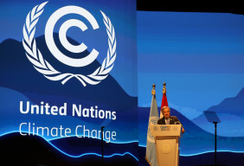
The financial paradox blocking clean tech: the COP28 negotiations are a complex, acrimonious, international fight over money:
How much capital is available to help developing countries transition to renewable energy and cope with extreme weather?
Where will that investment come from?
And critically, what kinds of interest rates will lenders charge?
Average global temperatures have already risen about 1.2 degrees Celsius above preindustrial levels. Without a rapid shift away from fossil fuels, scientists warn that catastrophic warming will destroy coastal cities, ravage agricultural land and imperil millions of lives.
And yet there is a bedeviling economic paradox inhibiting efforts to create a more sustainable world: It’s relatively easy to find financing for the dirty projects the world needs less of, but maddeningly difficult to finance the clean projects the world needs more of.
This mismatch is shaping projects across the globe. In the United States, rising interest rates are leading big companies to cancel plans for huge renewable developments. But the disconnect is particularly acute in the developing world, and especially Africa, where many people have little or no access to electricity.

Slide 26
Lessons from Past Wars
Most of these problems arise because the financing will be arranged through private banks
The Lessons of War finance suggest going around the banking system
This would allow government financing
And multilateral financing arrangements
The problem is that banks provide liquidity creation be undertaking private risk
Consider the Keynes-Schumaker-Kalecki Augmented Clearing proposals

Slide 27
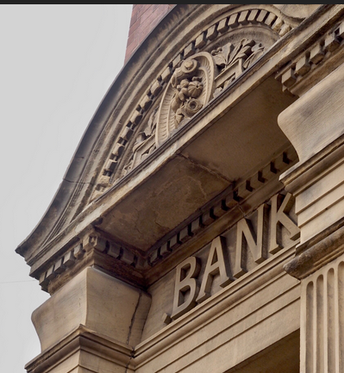
What blocked the original Clearing Proposal?
Wright Patman on WWII finance:
I am opposed to the United States Government, which possesses the sovereign and exclusive privilege of creating money, paying private bankers for the use of its own money. These private bankers do not hire their own money to the Government; they hire only the Government’s money to the Government, and collect an interest charge annually” (US House 1943, 38). Patman argued that “if money is to be created outright it should be created by the Government and no interest paid on it” (Ibid., 64).
A similar direct financing procedure was utilized in the United Kingdom for the 1914-18 war.
A similar procedure had been proposed in the aftermath of the Great Depression by the Chicago School of economists, led by Henry Simons. This is the so-called 100% reserve system which would require banks to hold government debt to fully cover outstanding liabilities.
Bank loans to finance government war expenditure would then generate an equivalent demand for government debt at interest rates that could be set by government. For this system to be fully equivalent would require the interest rate on government debt to be set at zero. This would make government debt equivalent to cash,
and makes clear the redundance of the intermediation borrowing deposits from private banks at positive interest rates

Slide 28

Can IT Help Government Finance Development
The elimination of private bank intermediation for government expenditure could result from the adoption of digital currencies.
These permissionless blockchain-based transaction systems were originally designed to eliminate not only the private financial system:
but also eliminated the government control and regulation of payments systems.
However, they show the application of the underlying accounting technology to government payment systems in the form of central bank digital currency (CBDC) or Central government digital currency (CGDC).
Permissioned government accounting systems could be used to effectuate government expenditures. The public would then become digital creditors to the central bank, or the Government Treasury department, rather than holding cash or private deposits.

Slide 29

If we have CGDC Do we still need Central Banks?
In proposals for public access to CBDCs the liabilities issued by Central banks are simply government debt and default free.
In addition, since there is no default risk existing regulatory arrangements and insurance schemes for the prudential regulations of private bank liabilities used as means of payment would no longer be required.
Indeed, there is no reason for the central bank to be involved and Central Government Digital Currency CGDC could be issued directly by a special department of the Government Treasury.
The Treasury would have government expenditure commitments mandated by Congress against digital liabilities to the public. Indeed, there could be special sections for different types of government expenditures, say on health or climate change.
Just as cash notes do not pay interest, are default free, these digital accounts would not pay interest and have no credit or default risk and thus more fully meet the Patman conditions.
The implication is that there would no longer be any regulatory or monetary policy role for the Central bank and it could be abolished.

Slide 30

Do we need an International Currency?
If all participants in the system had accounts with a permissioned central blockchain bookkeeper debits and credits could be represented in notional units of account representing claims on the system as a whole.
Why would creditors be willing to accept these account credits? The answer is that in this social accounting money of account system, credits balances have value because they can be used to extinguish debts incurred in the production of goods and services.
Keynes proposals for a Clearing Union were simply an extension of such a unit of account bookkeeping system. Paradoxically, it was rejected because of its ability to create default free credit -- but this is precisely what the private financial system does, but with the risk of endogenous financial instability.
This system was in fact used in the recovery of the European countries after the war as represented by the European Union patterned on Keynes’ proposal from the 1940s and a subsequent revision by Richard Kahn. This led to a plethora of proposals for regional clearing unions amongst developing countries in the 1960s.
As noted above, clearing systems based on unit of account balance sheet clearing have been developed by private sector institutions for several thousand years. Governments only recognized that they could be used for government finance in recent times. It is thus not surprising that private transactions systems have already been developed on these principles.

Slide 31
Reform the Financial Architecture:
Don’t replace the $ with another National Liability
Or a Basket of SDR reserves that are claims on national currencies
Since a central clearing system can be based on a notional unit of account there is no need for an international settlement currency. The overall creation of development finance will depend on the ability of the central bookkeeper to create the appropriate credit accounts designed to meet the various global development objectives. Surplus countries could earmark their system credits for expenditures on specific objectives. This is what was once represented as “Qualitative” rather than “Quantitative” Monetary policy.
More importantly, proposals such as Schumacher’s could allow national governments to retain their national units of account and parliamentary sovereignty over domestic monetary and fiscal policy.
The objective would be to provide for an international financial system that features all the advantages of Keynes’s clearing union proposal without the political impediments

Slide 32

Coda: Bitcoin is not sufficient –
Cybercurrencies such as bitcoin substitute the current reserve- backed notes or coins with a digital currency backed by a binary identification system verified by calculation and distributed ledger comparison.
They are meant to replace paper notes, which already bear a numerically unique serial number, with a binary identification stored on a series of computers that jointly verify the distributed ledger entries of asset transfers.
But aside from being employed by the bitcoin universe (miners who carry out the transaction verification are allocated new bitcoin) it is currently impossible to acquire new bitcoin without an exchange with the formal money system so that they are neither a full-fledged unit of account nor an effective means of settlement due to large fluctuations in their dollar value.
The verification system is presumed to be completely anonymous and secure because of the distributed verification of transactions.
However, the biggest difference between the bitcoin system and a settlement system is the former does not provide a balance sheet of debits and credits or provide a clearing system for net balances. Its distributed ledger system is simply a ledger recording of credit transfers to ensure veracity and security.
And in practice it has been neither secure nor fully anonymous. In fact, these cybercurrencies have been more successful in raising capital through IPOs of coins (called initial coin offerings or ICOs) than in providing money attributes or payment services.
Quantity theory via the backdoor

Slide 33
To be a real competitor to the current bank-based commodity money system, the first requirement is thus to replicate the account settlement system, that is, to take on the role of bookkeeper in the banking principle arrangement cited above. At present there is only one system that provides this possibility. Although it is based on mobile telephony, it has a radically different structure from existing mobile transfer systems.1
In this sense Webtel.mobi (WM) is the only currently operating system that meets this condition because it plays the role of the bookkeeper of an alternative settlement system for its TEL.mobi Group (TMG) members’ stored-credit values accounts through the WM system and its Inter- TEL.mobi account number (ITAN) account identification system. It acts as bookkeeper in the sense of crediting and debiting member accounts as they are created by transfer and used for telephony services.
A TMG member account is created via an electronic transfer into the member’s account from a member’s regulated bank account, card, or other traditional payment means to a currency subaccount within the WM multicurrency regulated bank account. Alternatively, an electronic transfer is made by an independent marketing agent (agent) or virtual specialized mobile provider affiliate (VSMP) to one of WM’s currency subaccounts within its multicurrency regulated bank account, after which the agent or VSMP will use that stored value on their own TMG member accounts to create and issue digital top-up vouchers (TUV) to TMG members in return for physical currency paid to the agent of the VSMP. The use of agents and VSMPs in this role is to provide access to TMG’s services to members without formal bank relations. Thus, the agents and VSMPs are subject to know-your-client (KYC) and anti–money laundering (AML) provisions. The possible currency subaccounts (currently 43) are determined by the geographical distribution of the systems’ members.

Slide 34

For further references see
jankregel.org

