Slide 1

The Economic Possibilities for Peripheral Countries
Lille Post-Keynesian Conference
The Economic Possibilities for our Grandchildren 90 Years Later
Daniela Magalhães Prates
Senior Economic Affairs Officer
Debt and Development Finance Branch
Globalization and Development Strategies

Slide 2
Outline
Setting the scene
Question and approach
Peripheral countries’ challenges
Asymmetries across the periphery
Final remarks

Slide 3
Setting the scene

Slide 4
Conference even more timing than in 2020
Covid-19 pandemic
Geopolitical tensions and conflicts
Cost-of-living crisis
Deepening climate crisis
Cascading crises/polycrisis

Slide 5
Keynes’ economic possibilities: 1930
Question: What can we reasonably expect the level of our economic life to be in the future?
Context
  Grand Depression: economic crisis => economic pessimism
  “Growing pains of over-rapid changes” ⬄ technological improvements, K accumulation
  Technological unemployment
  Countries lagging behind, suffering more

Slide 6
Keynes’ economic possibilities: 1930
Answer
  Neither the pessimism of revolutionaries nor reactionaries
  “In the long run, mankind is solving its economic problem”: it will not be a surprise, if “we are all of us, on average, 8 times better off in the economic sense than we are today”
  “Economic problem, the struggle for subsistence, almost has been hitherto the primary, most pressing problem of human race” => solve the social problem (inequality)
  Love of money not as a possession, but as a means to the enjoyments and realities of life; leisure
  Four things will govern our economic bliss
  1. Control population
  2. Avoid wars and civil dissensions
  3. Science
  4. Rate of accumulation

Slide 7
Current context and challenges
K accumulation, technological improvements, technological unemployment
Countries lagging behind, suffering more
Finance-led capitalism: love of money as a possession
Cascading crises: reinforced income inequality and wealth concentration
Beyond the economic problem
  Climate problem needs to be addressed to solve the economic and social problems

Slide 8
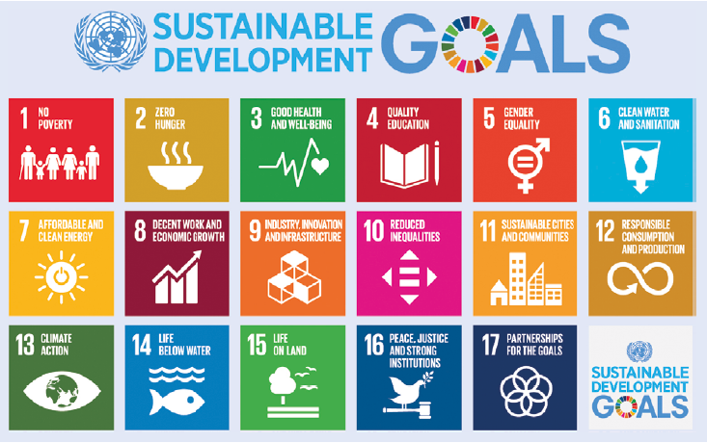
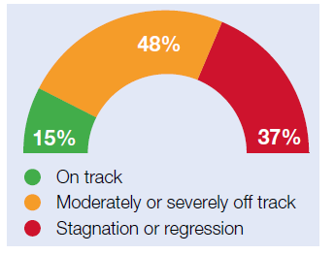
Current context and challenges
Cascading crises have reversed progress on the SDGs
Greater challenges to achieve sustainable development by 2030
At the mid-way point of the 2030 Agenda progress on the SDGs remains behind schedule.
Only 15% are due to be met
Notes:
The latest global-level data and assessments show that of the 140 SDG targets that can be evaluated, half of them show moderate or severe deviations from the desired trajectory. Furthermore, more than 30 per cent of these targets have experienced no progress or, even worse, have regressed relative to the 2015 baseline.

Slide 9
Question and approach

Slide 10
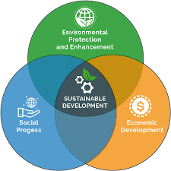
Question: How to achieve sustainable development in peripheral countries?
Notes:
The technological gap between the periphery and the center is the fundamental asymmetry for the Latin American structuralism. According to Prebisch (1951a, p.3), the international diffusion of technology is “slow and irregular”, shaping the periphery’s pattern of specialization, and resulting in a productive asymmetry (see also Porcile 2021). In Prebisch’s time, center countries were mainly producers and exporters of industrialized goods, and peripheral countries of commodities. Consequently, the exchange between center and periphery based on global free trade did not translate into gains for both – as argued by standard trade theories. This is due to the fact that the technical change originated in the center led to changes in prodution patterns and demand, resulting in a specialization of the center countries in goods with high income elasticity (industrialized goods), and of the peripheral countries in the production of goods with low income elasticity (commodities). Moreover, the periphery countries were featured by what Pinto (1976) called “structural heterogeneity”, i.e., modern and high productivity sectors (export activities) absorbed a small proportion of workers while the rest of the economy, featured by low-productivity sectors absorbed a much large proportion by workers. This heterogeneity implied the persistence of substantial productivity gaps, wage differentials between these two sectors, weak and fragmented labor markets, and workers with low bargaining power, resulting also in high income inequality (Prebisch 1951b; Porcile 2021).

Slide 11
Post-Keynesian-Structuralist Approach
Keynes => Hierarchical feature of the IMS => Currency hierarchy
  Not considered in the Economic Possibilities -> Treatise and proposals for BW conference
  England/UK perspective
  Monetary asymmetry between the issuer of the key -currency and other countries

Slide 12
Post-Keynesian-Structuralist Approach
Latin-American structuralism => Asymmetries between centre and periphery
    Impossibility of analysing the dynamics of peripheral countries independent of their position within the world economy.
    Peripheral economies have a different dynamic than those that developed earlier, becoming the ‘centre of the world economy.
    Inherently hierarchical ‘centre-periphery’ international economic system featured by persistent asymmetries
Notes:
The technological gap between the periphery and the center is the fundamental asymmetry for the Latin American structuralism. According to Prebisch (1951a, p.3), the international diffusion of technology is “slow and irregular”, shaping the periphery’s pattern of specialization, and resulting in a productive asymmetry (see also Porcile 2021). In Prebisch’s time, center countries were mainly producers and exporters of industrialized goods, and peripheral countries of commodities. Consequently, the exchange between center and periphery based on global free trade did not translate into gains for both – as argued by standard trade theories. This is due to the fact that the technical change originated in the center led to changes in prodution patterns and demand, resulting in a specialization of the center countries in goods with high income elasticity (industrialized goods), and of the peripheral countries in the production of goods with low income elasticity (commodities). Moreover, the periphery countries were featured by what Pinto (1976) called “structural heterogeneity”, i.e., modern and high productivity sectors (export activities) absorbed a small proportion of workers while the rest of the economy, featured by low-productivity sectors absorbed a much large proportion by workers. This heterogeneity implied the persistence of substantial productivity gaps, wage differentials between these two sectors, weak and fragmented labor markets, and workers with low bargaining power, resulting also in high income inequality (Prebisch 1951b; Porcile 2021).

Slide 13
Post-Keynesian-Structuralist Approach
Unregulated capital flows
Flexible and Fiduciary USD + Financial globalization
Technological and productive asymmetries
Monetary and financial asymmetries
External constraint
Non-international currencies
Volatile and costly external finance
Fixed-exchange rate
Bretton-Woods
Flexible-exchange rate
Technological and productive asymmetries
External constraint
Regulated capital flows

Slide 14
Peripheral countries’ challenges

Slide 15

Challenges
1950/60: Economic problem
    Latin-American structuralism (ECLAC and UNCTAD) => Periphery’s development paradox: the need for more trade, aid, transfer of technology and development finance to achieve industrialization/structural transformation and development and, hence, to withstand the long-term dependence on trade, aid, transfer of technology and development finance (Fajardo, 2022) §
2023: Economic, social and environmental problem
    Periphery is facing a new development paradox: the need for more trade, transfer of technology, aid and development finance to achieve climate-resilient and green structural transformation, and hence, to reduce the dependence on trade, transfer of technology, aid and development finance
Development challenges
Climate challenges
Debt challenges

Slide 16
Development and debt challenges
Looming debt crisis
+
Development crisis
High debt burdens previous to the Covid-19 pandemic
Cascading crises
Tightening monetary policy in the centre
Total External Debt Stocks of Developing Countries (US$ Billions)
Cascading crises
Wave of debt
Global financial crisis
Source: UNCTAD secretariat calculations based on data from World Bank and IMF.

Slide 17
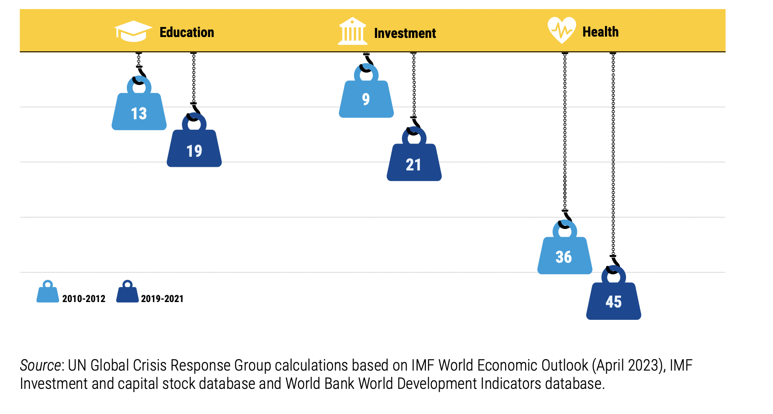
Development and debt challenges
Number of developing countries spending more public resources on net interest than on education, investment or health
3.3 billion people now live in countries where debt interest payments are greater than expenditure on health or education

Slide 18
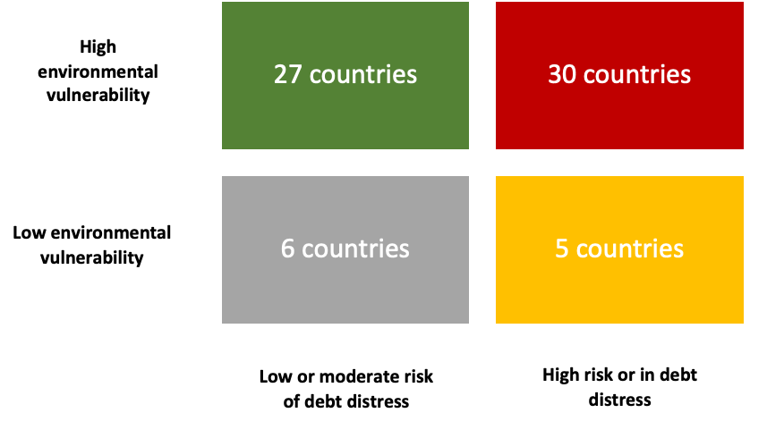
Climate and debt challenges
Overlap extends beyond PRGT-eligible countries
Climate-vulnerable countries pay nearly 10 per cent more in overall interest costs on international bonds
Over half of debt upsurge in vulnerable countries stems from funding disaster recoveries
Overlap of debt and climate vulnerabilities in
PRGT-eligible countries, 2023
Debt-climate vicious cycle
Greater vulnerability to climate-related shocks
Heightened obstacles and exposures to green transition
Source: UNCTAD Secretariat calculations based on IMF LIC DSA country list (August 2023) and Notre Dame Gain Climate Vulnerability Index (ND-GAIN
Notes:
The overlap between climate and debt vulnerabilities occurs through two primary channels. Firstly, developing countries suffer greater climate vulnerability than developed countries. When climate shock strike in highly indebted developing countries, they cripple economic growth, disrupt tourism, and diminish the country’s ability to mobilise domestic resources for climate adaptation – a crucial step in reducing climate vulnerability and enhancing climate resilience. This damage also strains the government budget due to infrastructure repair costs and increased social expenses. Consequently, post-climate shocks, external borrowing tends to rise with higher costs due to higher perceived creditor risk, while foreign exchange revenues drop, further deepening debt vulnerability. Some assessments suggests that over half of debt upsurge in vulnerable countries stems from funding disaster recoveries. This situation may worsen if the country engages in more carbon-intensive activities to boost export revenues, worsening climate change impacts.
Secondly, developing countries encountered heightened obstacles in transitioning to a low-carbon economy. Compared to developed countries, they rely more on brown activities, are less diversified and less competitive in high-tech sectors. Consequently, the investment requirements for climate mitigation and diversifying the economic structure are much higher. However, while their ability to make such investments are hindered by high debt burdens, increased external climate finance, including debt, will be required to undertake them. Yet, this will exacerbate their fragile external position. On the one hand, they heavily depend on exports from emission-intensive sectors whose prices and external demand will fall. On the other hand, they will need to import technology, capital goods and inputs for green activities. Consequently, at least in the short term, the transition will jeopardize their capacity to generate foreign currency revenues necessary for servicing rising external debt burdens, further reinforcing their debt vulnerability.

Slide 19
Vulnerability to climate-related shocks
GDP and taxes
Domestic resources mobilization for climate adaptation
Climate shocks in a high indebted country
G expenditures
External debt
Export revenues
Vulnerability to climate shocks
Debt vulnerability
Carbon-intensive activities
Climate impacts

Slide 20
Heightened obstacles to green transition
More brown sectors
Less diversified
Less competitive in Hig-tec
Higher invest. to green structural transformation
Brown exports
Green Imports
Gamacho, Espagne, Godin et al. (2023): Developing countries’ macro exposure to this transition depends on their reliance on carbon-intensive industries as a source of foreign currency, fiscal revenue, employment and wage income
Net exports
External constraint
External climate finance/debt
Debt vulnerability

Slide 21
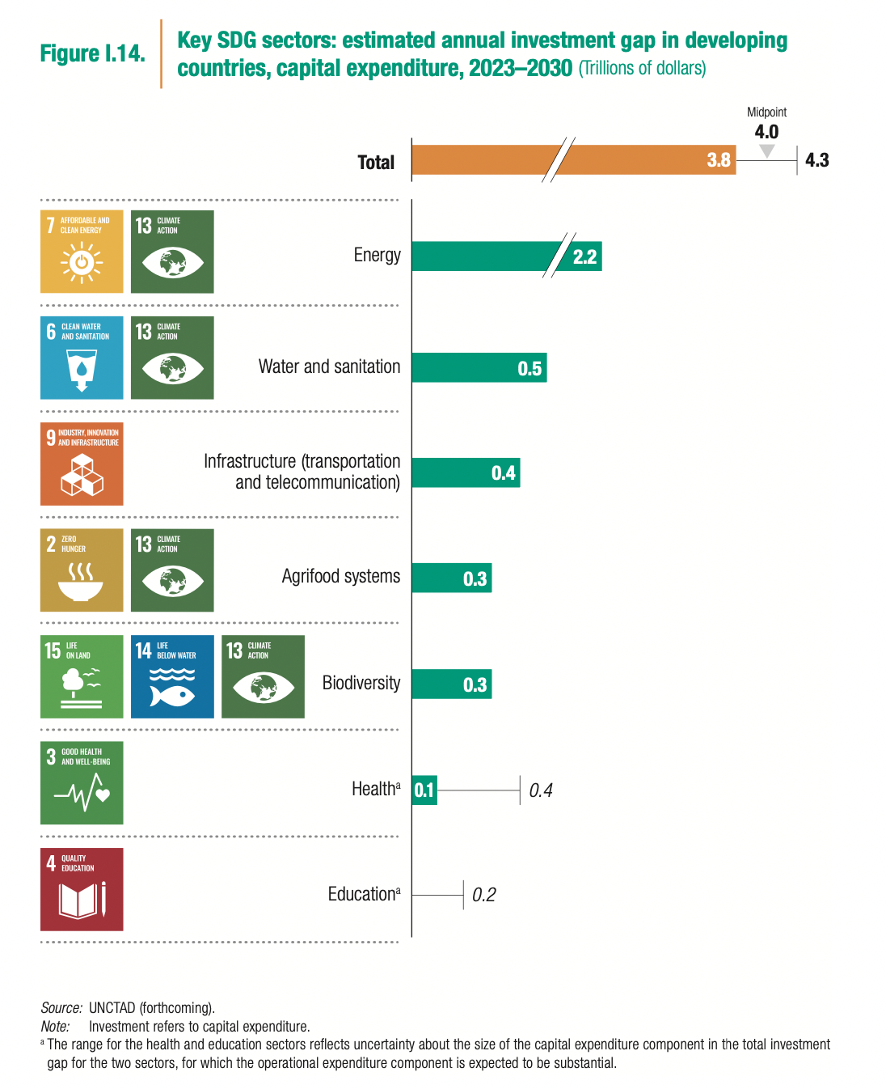
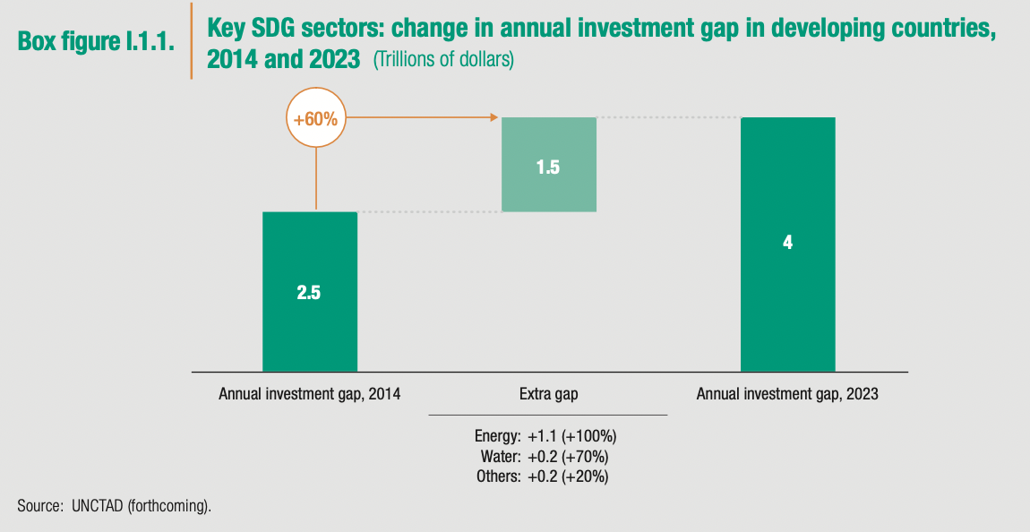
Financing gap at the mid-point of the 2030 Agenda
Source: UNCTAD, WIR, 2023, ch. 1

Slide 22
Asymmetries across the periphery

Slide 23
Monetary and financial asymmetries
Some peripheral countries face more significant challenges to address the new development paradox than others
Three groups
  Emerging-market economies (EMEs)
  Frontier-market economies (FMEs)
  Other peripheral countries
Integrated in financial globalization
Financial periphery

Slide 24
The financial periphery
EMEs and FMEs are two groups of peripheral countries that engaged in financial globalization at different moments.
  EMEs: mainly upper-middle income peripheral countries (UMIC), since the 1990s
  FMEs: mainly low- or lower-middle-income peripheral countries (LICs and LMICs), during the K flows boom after the GFC
J.P. Morgan EMEs Index - EMBI + (25)
J.P. Morgan Frontier Index - EMBI NEXGEN (38)
Notes:
Among the 37 FMEs, there were 3 low-income countries (LICs) – which are also least developed countries (LDCs) –, 20 lower-middle income countries (LMICs) – among which are 3 LDCs –, 11 upper-middle income country (UMIC), among which 3 small island developing States (SIDS) and one more high-income SIDS. Moreover, 14 FMEs were eligible for the International Monetary Fund (IMF) Poverty Reduction and Growth Trust (PRGT) and for the World Bank International Development Assistance (IDA) while 10 participated in the heavily indebted poor countries (HIPC) initiative

Slide 25
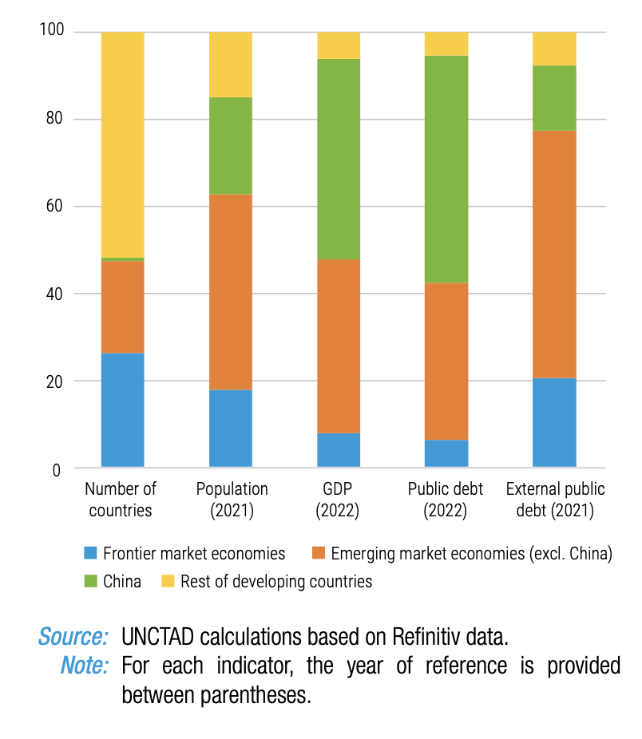
Asymmetries across financial periphery
Shares with respect to all developing countries’ aggregates (%)
FMEs are particularly exposed to monetary and financial asymmetries
  Contribution of less than 10% of developing countries’ total output, but carry 20% of the external public debt
Source: UNCTAD TDR (2023), ch. 2

Slide 26
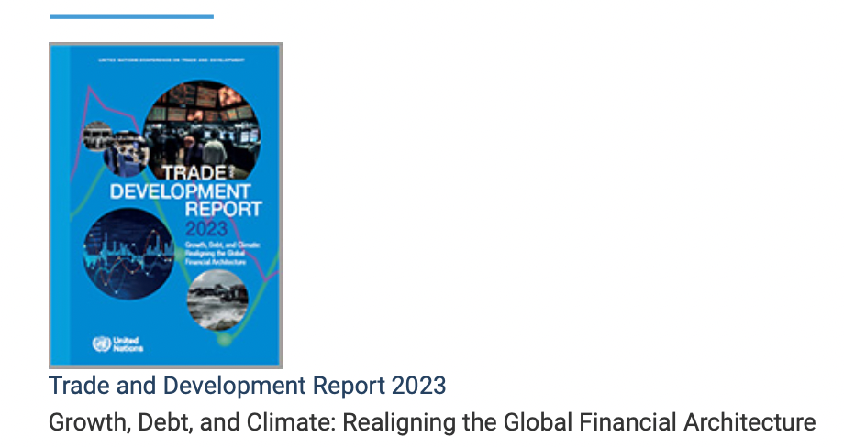
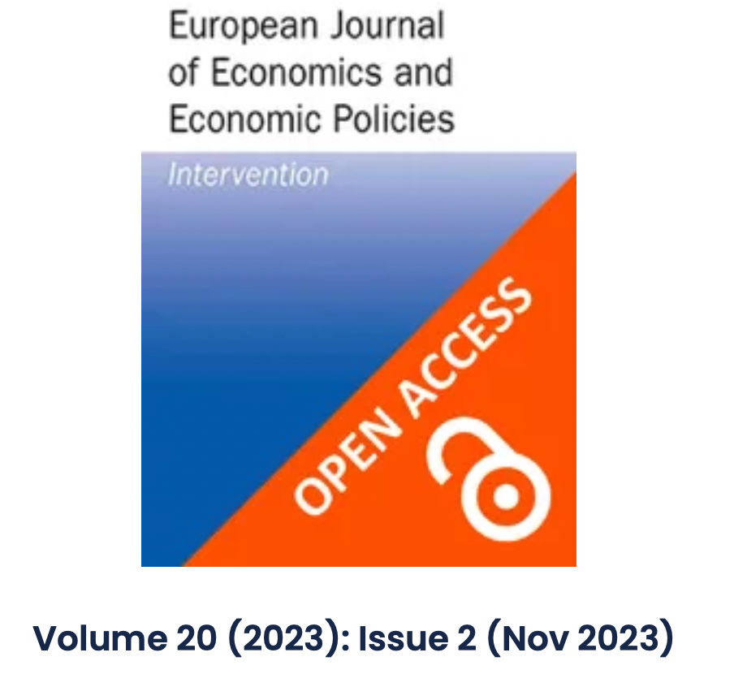
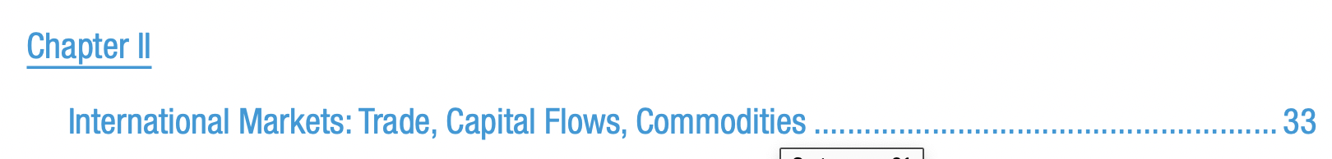
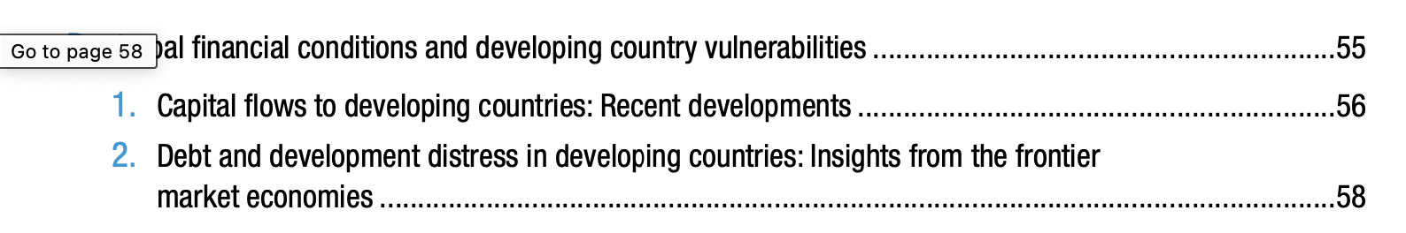
Sources
Frontier-market economies as a new group of the financial periphery: patterns and transmission channels of global shocks
Daniela Prates, Barbara Fritz and Luiz Fernando de Paula

Slide 27
Why have FME’s become an asset class?
Center-periphery dynamics of financial globalization: integration between unequal partners
External finance
Dependency
Global investors/creditors
Financial Periphery
Functionality
Financial returns

Slide 28
Functionality: supply side
Push factor: post-GFC capital flow boom
Global investors searching for yield even more aggressively ⬄ historically low-interest rates and quantitative easing policies in the centre
Global investors targeted assets issued by EMEs but also went after a new asset class – securities issued by the FMEs – searching for higher yields and opportunities for risk diversification.
New financial strategies to invest in the financial periphery => passively managed or benchmark-driven funds

Slide 29
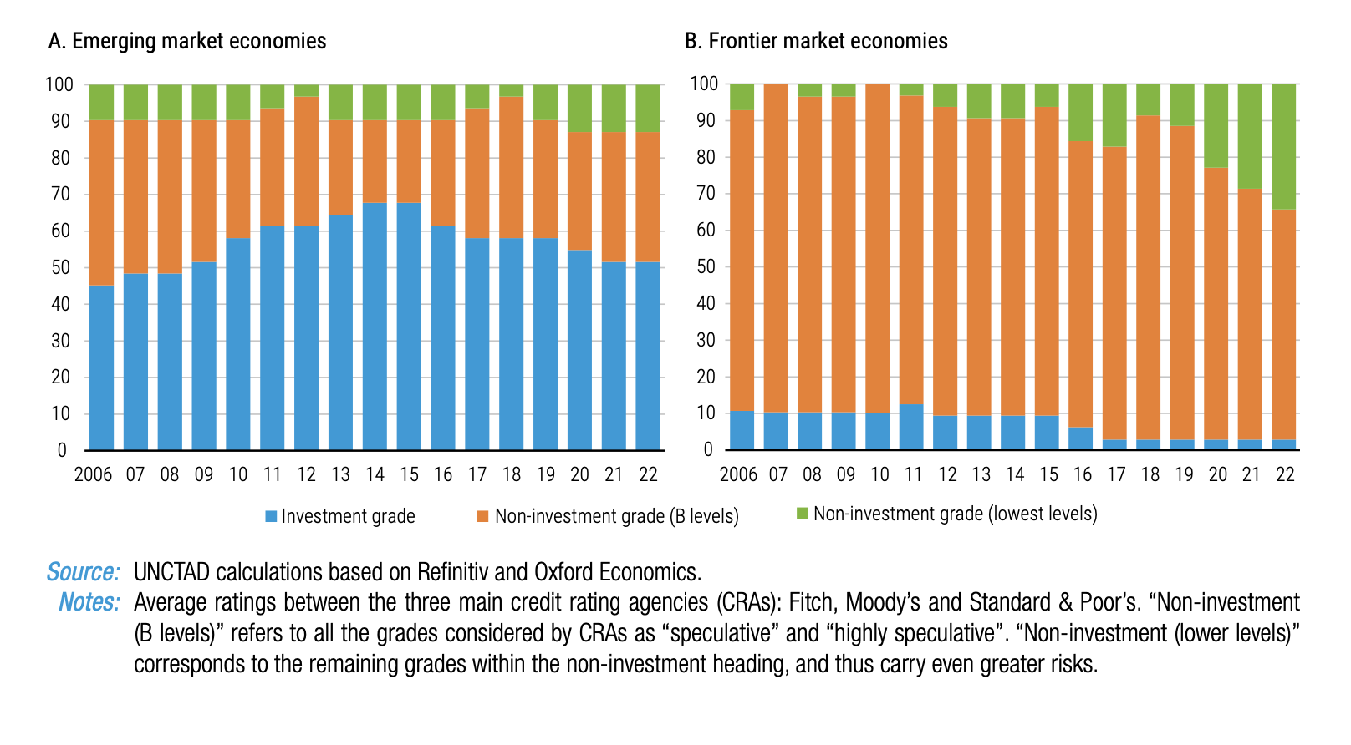
Functionality: supply side
Inclusion of FMEs in this investment pattern in 2011: launch of the J.P Morgan NextGen (17 countries to 38 in 2020)
FMEs fill the vacuum in the high yield/non-investment grade segment left by major EMEs
Distribution of credit ratings in EMEs and FMEs (%)
UNCTAD TDR (2023), ch. 2
Notes:
They have relied increasingly on passively managed or benchmarked-driven funds, which track or closely follow a flagship benchmark index that has a predefined list of countries and securities with specific weights, i.e., they allocate their portfolio according to the share of each country’s bonds in the index. Examples of these indexes are the J.P. Morgan’s Emerging Market Bond Index (EMBI) and the Next Generation (NexGen) – which is the Benchmark index for the FMEs – for sovereign bonds and Morgan Stanley’s MSCI indexes for equities – which also have specific indexes for EMEs and FMEs. As El-Erian (2023) stresses, besides charging lower fees relative to active portfolio management, passive portfolio management is particularly attractive in a global context where the combination of very low interest rates and massive injections of central bank liquidity boosted virtually all assets and increased the correlations across asset classes.
the inclusion in these indexes has stimulated the issuance of new foreign bonds by FMEs since the benchmark-driven funds have to allocate a share of its portfolio to these countries’ sovereign bonds.

Slide 30
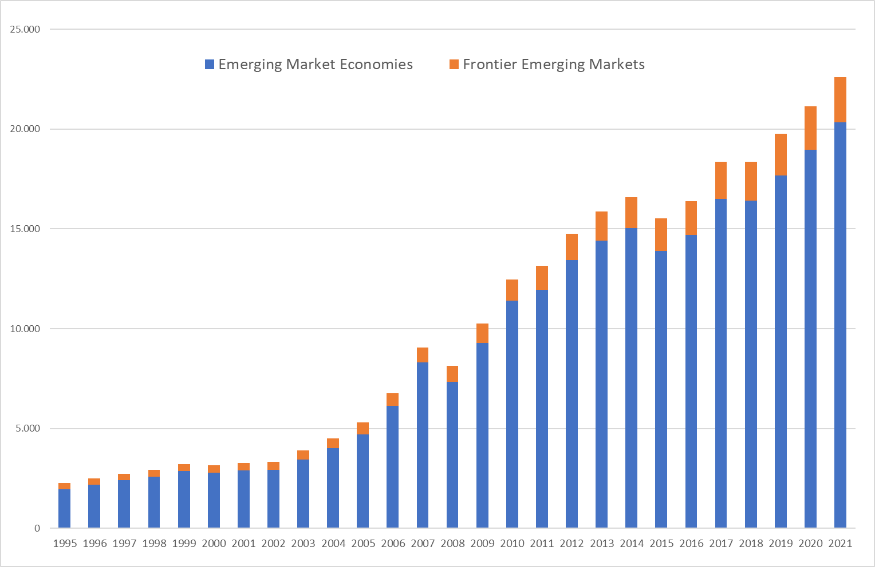
Functionality: supply side
Why EME’s climbed the rating scale?
Global external liabilities of EMEs and FMEs - USD billion
      Increasing share in global investors’ portfolios => less volatility => lower returns
      FX reserve accumulation and “sound” macro policies => positive impact on CRA evaluations
Source: Prates at. al 2023 based on Milesi & Ferreti
Notes:
new options of high-risk investment, as part of their portfolio diversification and searching for yield.
Although this share is still small from a global perspective, it increased and is much greater than the share of FMEs

Slide 31
Dependence: demand side
FMEs’ sovereigns started to tap international capital markets to close the balance of payment gap and development financing needs.
Many FMEs climbed the income-scale from low-income (LICs) to lower-middle-income (LMIC) countries shortly after the GFC and lost access to affordable external finance and ODA.
Angola
Nigeria
Mongolia
Pakistan
Vietnam

Slide 32
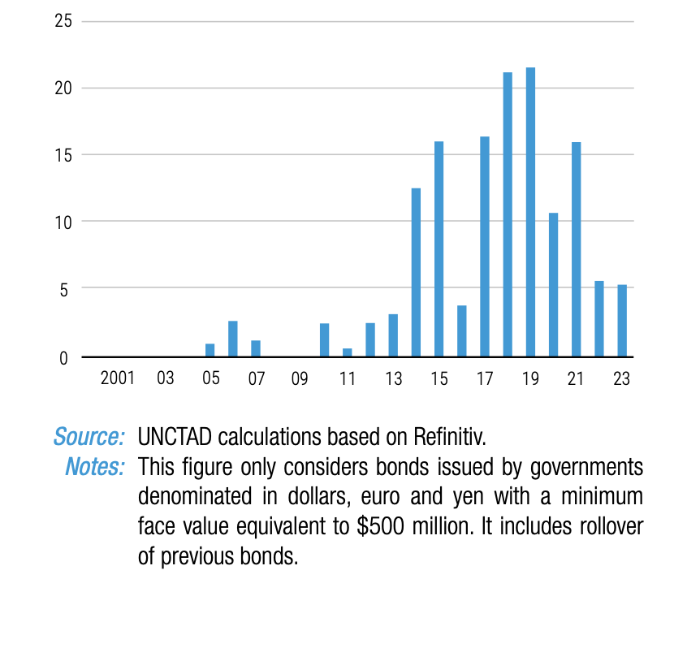
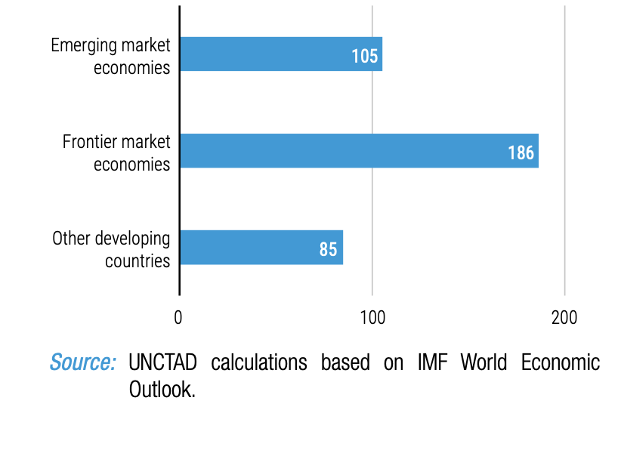
Boom in FMEs’ bond issuance
Bond issuance by FMEs has been at the core of the massive accumulation of external public and publicly guaranteed (PPG) debt over the past decade
External gross issuances (USD billions)
Growth of PPG debt (USD billions), 2010-2021 (%)
Source: UNCTAD TDR (2023), ch. 2

Slide 33
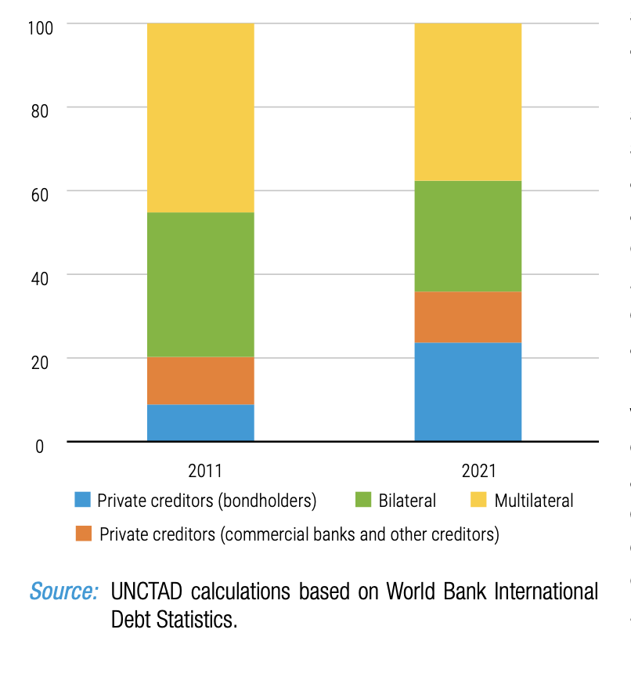
FMEs’ greater reliance on private creditors
PPG debt’ creditor composition (%)
The share of private creditors in FMEs’ PPG debt has almost doubled from 19.6% in 2011 to 35.9 % in 2021
Bondholders account for 8.8% and 23.7%.
Source: UNCTAD TDR (2023), ch. 2

Slide 34
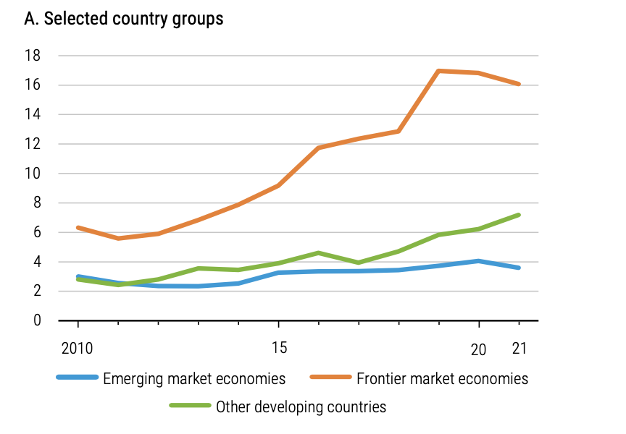

FME’s public finance under pressure
PPG external debt service to government revenues debt’ creditor composition (%)
Growing debt service obligations reduce available resources for crucial public expenditures
26 out 37 FMEs were spending more on external PPG debt service than in education or health by 2021
Source: UNCTAD TDR (2023), ch. 2

Slide 35
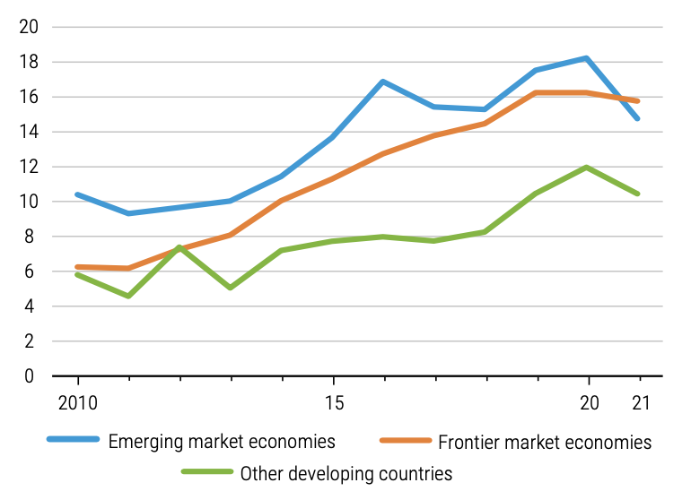
FME’s external debt service drains export revenues
PPG external debt service to export revenues (%)
Among the 25 countries with the highest proportion of export revenues allocated to total external debt servicing in 2021, over half (13 countries) were FMEs
Source: UNCTAD TDR (2023), ch. 2

Slide 36
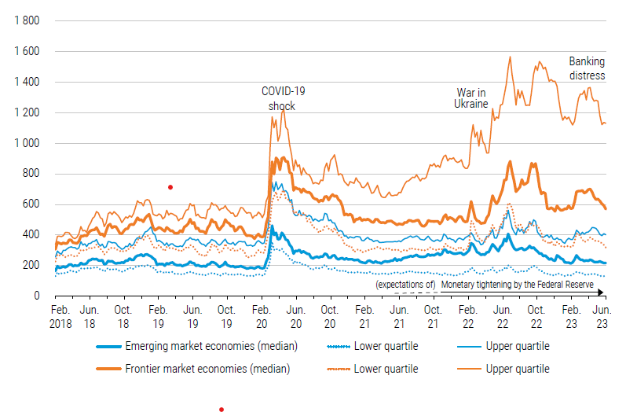
FMEs are at the forefront of cascading crises
Bond spreads with respect to the Treasuries of the US (b.p)
Cascading crises laid bare FMEs’ greater external vulnerability
FMEs have been hit more by external shocks than EMEs
FMEs: higher spreads and higher spread volatility
Source: UNCTAD TDR (2023), ch. 2
Notes:
, FMEs’ external sovereign bonds faced greater repricing and, consequently, sharper swings in spreads than those of EMEs.

Slide 37
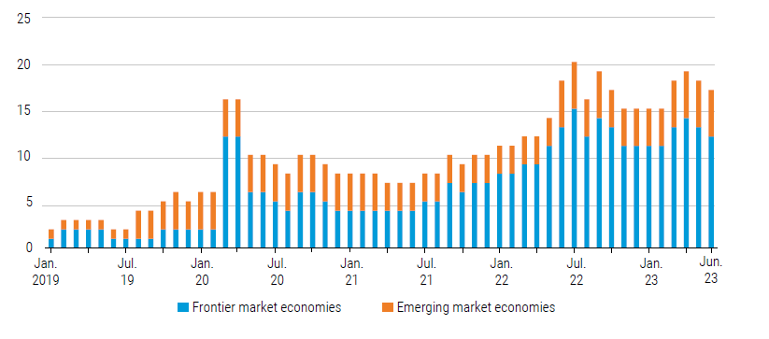
FMEs are at the forefront of cascading crises
Growing number of FMEs are going into distress
Bond spreads above 1,000 b.p above US Treasuries (number of countries)
Source: UNCTAD TDR (2023), ch. 2
Notes:
, FMEs’ external sovereign bonds faced greater repricing and, consequently, sharper swings in spreads than those of EMEs.

Slide 38
FMEs are at the forefront of cascading crises
Developing countries’ defaults and restructurings after the COVID-19 pandemic
Out of 5 developing countries that defaulted after the pandemic, 4 were FMEs
One FME completed (Belize) and another (Ethiopia) applied to a debt restructuring under the G20 Common Framework for Debt Treatment beyond DSSI
Country group | Defaults | Debt Restructurings
Frontier-market economies | Ghanaª | Belize
 | Sri Lanka | Ethiopiaª
 | Suriname
 | Zambiaª
Other peripheral countries | Malawi | Chadª
a. Participating in the G20 Common Framework
Notes:
during the peak of the crises – COVID crisis and Ukranian crisis – average spread of sovereign bonds of Frontier economies are much higher compared to emerging economies. In September 2022 it reached 1518 points to frontier economies against 361 points to emerging economies. Speculative-grade bonds offer higher yield assets for global asset managers, but they are also the first victims of investors’ flight to quality during bust phases.

Slide 39
What explains the greater vulnerability of FMEs compared to EMEs to external shocks

Slide 40
Monetary and financial asymmetries
Position in the currency hierarchy => updates needed; original version only includes EMEs (Andrade and Prates, 2013; Paula, Fritz and Prates, 2016)
Position in the financial hierarchy => new concept to understand the asymmetries across the financial periphery

Slide 41
Updating the currency hierarchy (CH)
      At the international level, currencies are ordered along their liquidity premia
      Currencies at the lower end are more vulnerable to global shocks => greater ER volatility
      Difference in the liquidity premia of EMEs and FMEs is not wide => non-international currencies
Source: Updated based on Andrade and Prates (2013); Paula, Fritz and Prates (2016)
Notes:
Figure 5a also depicts a threefold differentiation within the bottom part of the currency hierarchy that emerged over the last decades. First, when we use the global turnover in foreign currency (covering all financial contracts between different currencies) as an indicator of the use of a currency as a means of payment at the international level, we see that (i) the Chinese RMB climbed the hierarchy above the other EMEs currencies from 1% in 2001 to 7% in 2022 (BIS 2022).
Second, the currencies of the big EMEs, such as the Brazilian Real, the South African ZAR and the Mexican peso, experienced a slight increase, from zero to one or two per cent in the same period. However, in the latter cases, even this small increase is somehow misleading since it does not stem from an increased liquidity premium, but instead reflects the demand for them as speculative assets associated with the greater liquidity and deepness of their foreign exchange derivative markets (Orsi 2019; Ramos 2019).
The third, and most recent change at the bottom of the currency hierarchy is the entry of many LMICs and a few LICs – the FMEs - into the global financial market (see section 2).

Slide 42
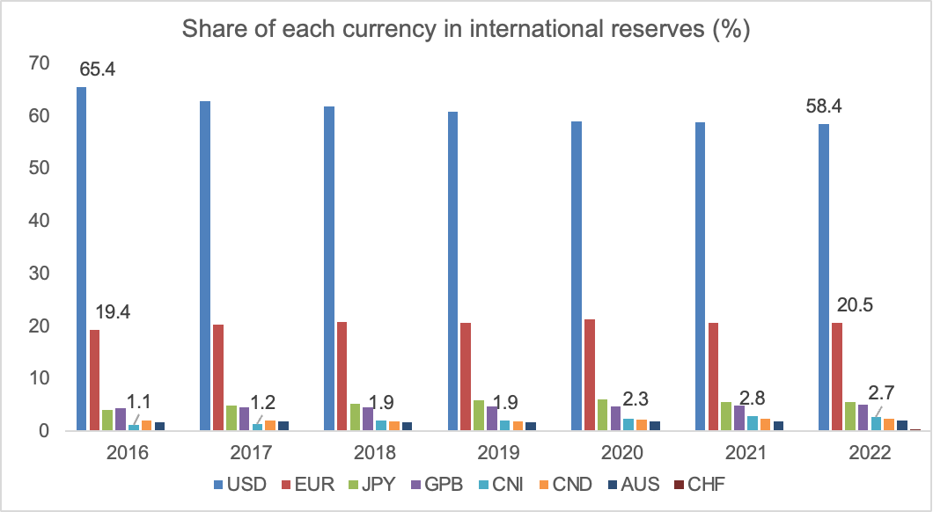
The monetary asymmetry and the currency hierarchy
Source: Currency Composition of Official Foreign Exchange Reserves (COFER), IFS

Slide 43
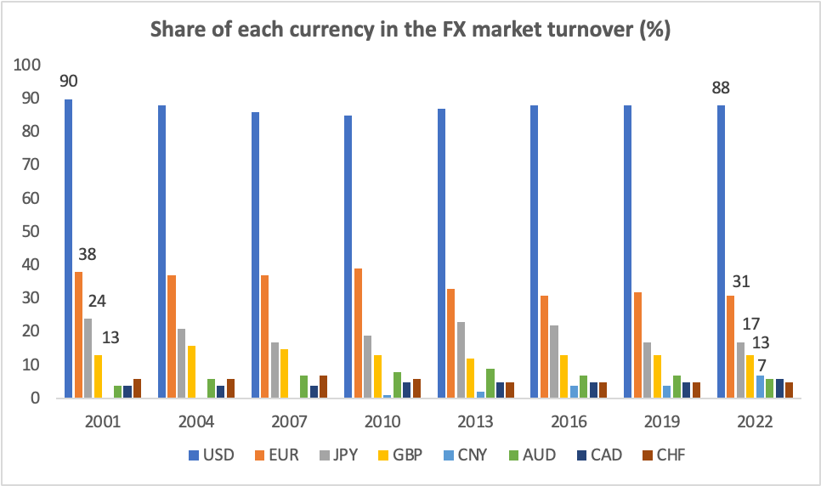
The monetary asymmetry and the currency hierarchy
Source: BIS Statistics

Slide 44
The monetary asymmetry and the currency hierarchy
A snapshot of the IMS
Unit of account
Source: ECB (2022)

Slide 45
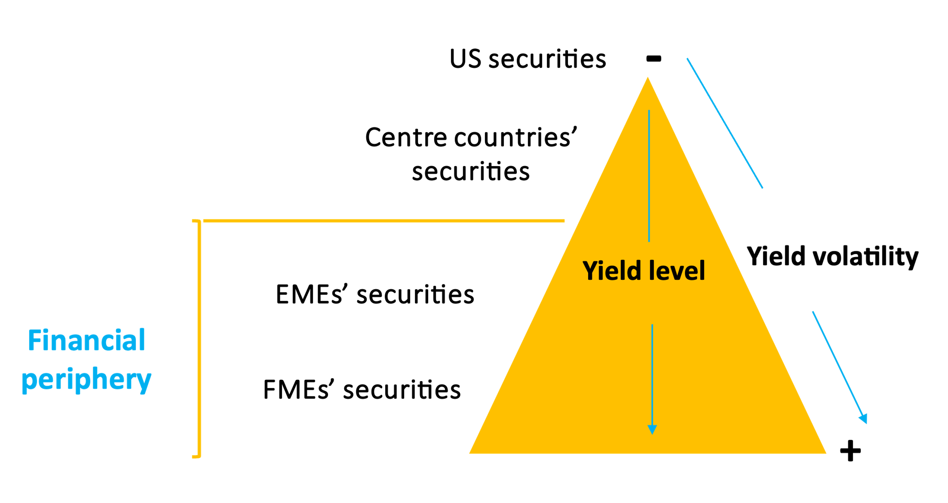
Financial hierarchy (FH)
The securities issued by the US, other centre countries, and the financial periphery are hierarchically positioned according to their yield.
FME’s securities at the bottom of the FH
Different international financial integration pattern
Source: Prates, Paula and Fritz (2023)
Notes:
the securities issued by the United States, the other centre countries and the financial periphery are hierarchically positioned according to their yield. The relative distance between EMEs and FMEs becomes clearer in this figure as the securities of these two country groups are farther away from each other regarding the yield they offer to international investors than their currencies regarding their liquidity premia. Moreover, the financial hierarchy only includes the securities of countries from the financial periphery – i.e., that joined financial globalisation -, thus excluding LMICs and LICs that are not FMEs and are positioned at the bottom of the currency hierarchy.

Slide 46
Government debt as % GDP
Financial hierarchy (FH)
As external sovereign bonds denominated in FX account for a greater share of government debt of FMEs than EMEs => yield volatility harms relatively much more FMEs’ sovereigns.
Source: Authors’ elaboration with data extracted from IMF (2020).
Notes:
the recent tendency of increasing the issue of government debt denominated in local currency in emerging economies does not apply to frontier economies as they issue mostly government debt denominated in foreign currency. That means that they are much more subject to the problems related to original sin.

Slide 47
Final remarks

Slide 48
Hierarchies are intertwined
Center-periphery dynamics of financial globalization swelled the financial periphery, including the FMEs as new unequal partners.
  Or paraphrasing Rosa Luxemburg in “Accumulation and Imperialism” (“Imperialism is always expanding its border to include new countries to be exploited”), financial globalization is also always expanding its border to exploit new peripheral countries
Yield needs to compensate for a lower liquidity premium
Higher yield of FMEs’ sovereign bonds: one driver of the greater external debt vulnerability
Vicious cycle: global investors demand a higher yield to compensate for the major credit risk
High yield levels also explain the predominance of sovereign external bonds
FMEs face greater financial challenges in addressing the new development paradox and achieving sustainable development
How can we simultaneously reduce the gap in GDP per capita between the centre and periphery, increase equality and protect the environment? (Porcile et al., 2023)
Notes:
: yield needs to compensate for the lower currency premium and the greater exchange rate volatility (and risk) of FMEs’ currencies.
Higher yield FMEs’ sovereigns need to pay in their external bonds is one determinant of their greater external debt vulnerability than EMEs’ sovereigns.
Simultaneously, a vicious cycle occurs: global investors also demand a higher yield to compensate for the major credit risk due to this greater vulnerability.
The high yield level also explains the predominance of sovereign external bonds, as FMEs’ private corporations and financial institutions would need to pay an additional credit risk to tap international capital markets.

Slide 49
Neither pessimism of revolutionaries nor of reactionaries?
More to the pessimism of revolutionaries
Radical changes are needed in international governance
  An enabling a multilateral trade system
  Transfer of green technology from developed to developing countries
  Reform of the Global Financial Architecture

Slide 50
Reform of the global financial architecture
Make the system more inclusive
  Improving the participation of developing countries in the governance of the global financial architecture.
A truly Global Financial Safety Net (GFSN)
  Strengthened use of SDRs, suspension of IMF surcharges and increased quota-access windows to IMF emergency financing.
Regulation of capital flows
Sovereign debt workout mechanism
  Development-focused debt sustainability analysis
Scale-up of affordable development finance and grants => Public international financial system
  Boost in concessional loans by MDBs/RDBs + state-contingent clauses + bear currency risk + increase lending in local currencies + strengthened cooperation with NPB
  Consolidating climate funds and leverage through MDBs
  Ideally, increase and, at least, meet ODA and climate financing commitments
  Adopting a new criterion instead of income thresholds for eligibility to such finance (MVI)
UN Stimulus package
UN Summit for the Future’s IFA Policy Brief
TDR (2023), part II, forthcoming
  Otherwise, the centre-periphery dynamics of financial globalization will include further LMICs and LICs into international capital markets with deleterious consequences for green transition in the periphery and sustainable development
Notes:
Periphery as dependent and functional to the center

Slide 51
Thank you! daniela.prates@unctad.org

